Slide 1
International Undergraduate Student Introduction to Western Libraries
Monica Fazekas & Shiyi Xie
Student Engagement and Outreach Librarian
Teaching and Learning Librarian, STEM Disciplinary Coordinator
September 17, 2018
Notes:
Good afternoon everyone. Welcome to Western, to London ON and to Canada!
My name is Monica Fazekas and I’m the Student Engagement and Outreach librarian. I am Shiyi Xie, Teaching and Learning Librarian and STEM Disciplinary Coordinator

Slide 2
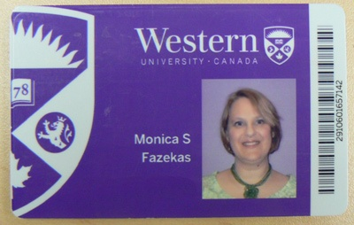
6 libraries + 3 affiliate libraries
Western Libraries’ locations and card
Notes:
You should have a campus map handout
On main campus there are 6 Libraries – organized by discipline + 3 affiliated college libraries – you can use them ALL
your Western One ID card is also your library card (same with your Western ID – username – and password) and your print/copy/scan card
-Never share your card or ID & password
-since you live in London – also have access to London Public Library – they are also a great resource
-Monica

Slide 3
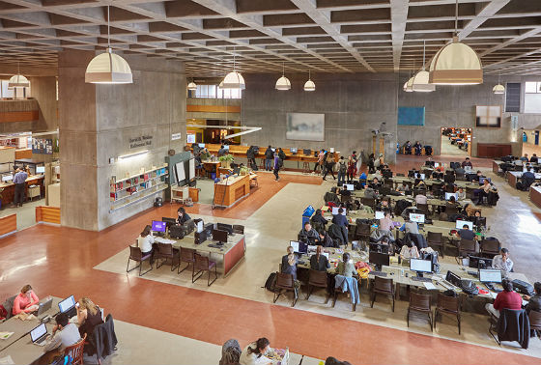
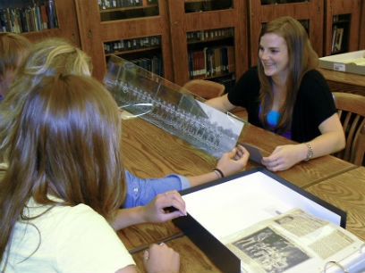
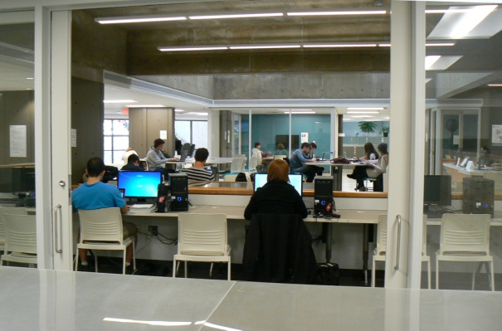
The D.B. Weldon Library
Arts & Humanities, Information
& Media Studies, Social Sciences
ARCC – Archives and Research Collections Centre
Map and Data Centre
Special Collections, Storage,
& University Archives
Located off of first floor of Weldon
Provides map, data, and GIS services
Located in the basement of Weldon
Notes:
The D.B. Weldon Library is the largest library. It supports Arts and Humanities, Information and Media Studies and the Social Sciences.
Two of our services are accessed through Weldon.
The Archives and Research Collections Centre (commonly referred to as the ARCC) houses Special Collections (rare books and materials), Regional Collections (local history), and the University Archives – this is where you can find a number of primary sources (particularly humanities and social sciences)
The Map and Data Centre is located on the ground floor of Weldon and provides map, data and GIS (geographic information systems) and statistical services. GIS has cross-disciplinary applications being used in biology, civil engineering, earth sciences, geography, history, literature etc. The Centre provides access to GIS tools through workstations; it also supplies local, regional, national, and international data and imagery through various online spatial data directories. They offer research help and instruction on GIS information resources.
GIS Day will be on November 14th (workshops, presentations)
-Monica

Slide 4
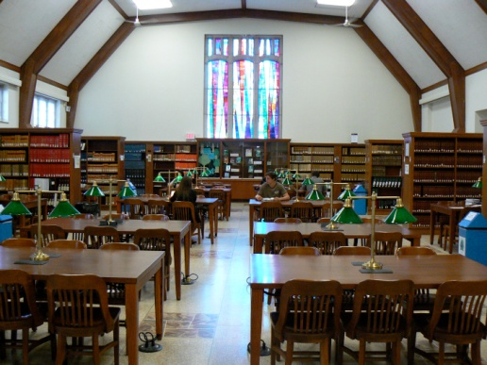
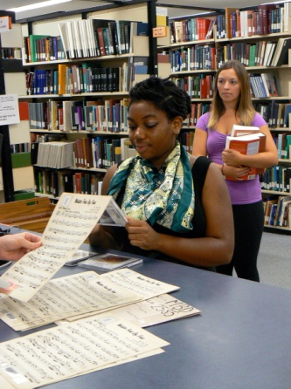
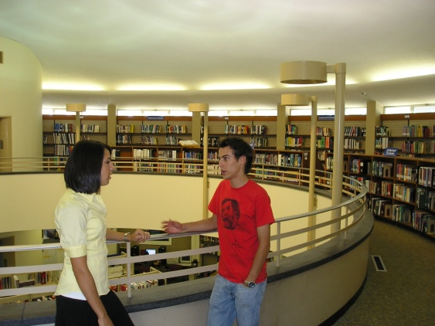
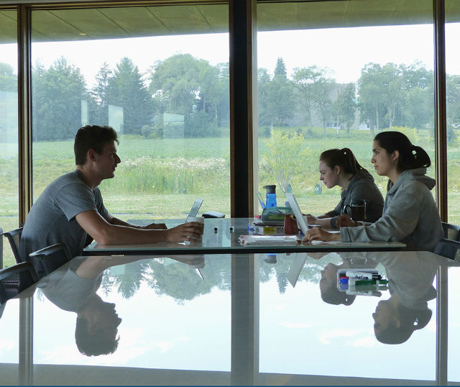
Allyn & Betty Taylor Library
John& Dotsa Bitove Family Law Library
Engineering, Science, Health Sciences, and Schulich School of Medicine & Dentistry
C.B. “Bud” Johnston Library (Business)
Music Library
Education Library
Notes:
The Allyn & Betty Taylor Library is the 2nd largest library on campus and it supports Engineering, Science, Health Sciences and the Schulich School of Medicine and Dentistry
-Although the primary user groups for the law, business, music and education libraries the are the students, faculty and staff of their associated faculties – these libraries and their resources (Business, Education, Music and Law) are open to everyone.
different libraries are busy at different times (e.g. during April exams the Business Library is fairly empty, so you can easily find a study space in there.)
-Monica

Slide 5
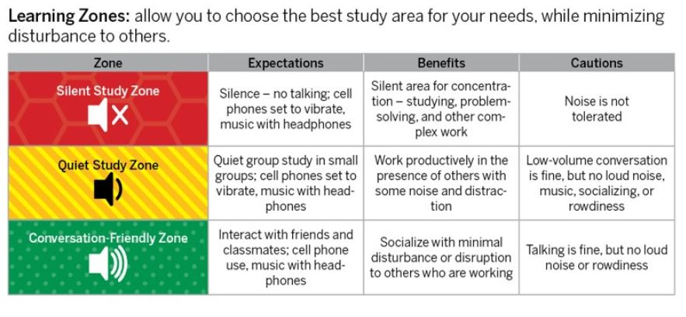
Learning Zones
Notes:
- Libraries have different study zones – Silent (no talking at all), Quiet (quiet small group discussions) & Conversation Friendly – can find maps with study zones online in the library
-most professional libraries are a quiet study zone
– for Weldon –the higher you go the quieter; for Taylor – generally the lower you go the quieter
-Monica

Slide 6
Library Website - Your Portal Visit us online anytime anywhere
lib.uwo.ca/
Notes:
Library website is your portal to information
Loan periods (28 days + 3 renewals
Getting Started:
-videos and how tos - short 2 minute videos that explain how to do something - how to search, evaluate sources etc., how to cite in APA etc.
Find Study Space for room booking (media/collaborative tables);
My library account (never have fines! – can renew online), show - mine
Materials from another University - RACER (not overnight), recommend a purchase (even undergrads) – can’t guarantee we’llget it, but we’ll try
Hours
Contacts page
-Monica

Slide 7
Scenarios
Finding course material
Finding information
Research Guides and Databases
Scholarly vs Popular sources
How to get materials from other libraries
Citing
Notes:
We thought it might be helpful to work through some of the most common questions and problems that we help students with in the library.
Monica

Slide 8
Scenario 1: Finding course material
This article will help you with your assignment. It’s in the library.
Kumar, S. A., Sridhar, K. & Kumar, G. V. 2018. Heat Transfer Analysis of Solar Air Heating System for Different Tilt Angles. Applied Solar Energy 54, (1): 17-22.
Notes:
A common problem that students face is that they are told by their instructors to read Article XYZ and it’s available at the library. Well, what exactly does this mean? What multiple things COULD this mean? Any ideas? [let the students come up with some ideas- and try to find this…show them course readings, then show them how to search for an article in the library search…then show them how to find a print journal article (that’s where this one is).
-Shiyi

Slide 9
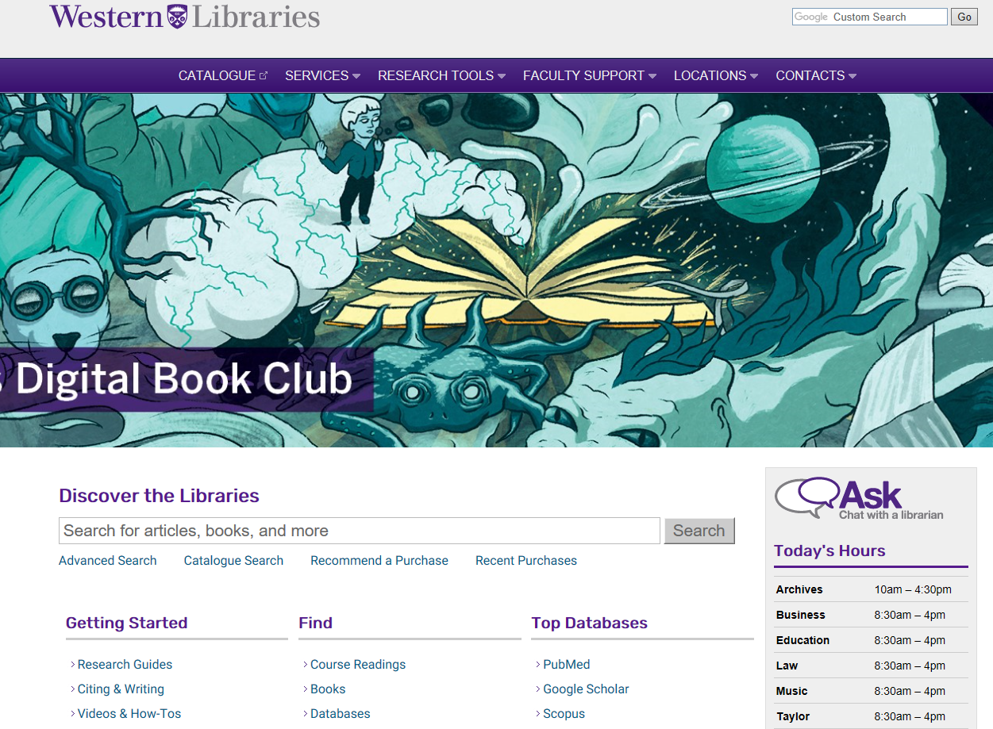
Scenario 1: Finding Course Material
Notes:
Depending on your professor, your course readings might be in OWL
-Shiyi

Slide 10
Course Readings
Notes:
Log in with your Western ID (same as your email) and you’ll get your readings
-Shiyi

Slide 11
Catalogue Searching
Notes:
If not course readings – need to find journal in the library catalogue (catalogue is good for exact title searches)
Show places for catalogue search on page
-Shiyi

Slide 12
Notes:
Search journal title not journal article
-Shiyi

Slide 13
Your Turn! (2 min)
Do we have this article in print in the library?
Kumar, S. A., Sridhar, K. & Kumar, G. V. 2018. Heat Transfer Analysis of Solar Air Heating System for Different Tilt Angles. Applied Solar Energy 54, (1): 17-22.
Notes:
Remember by title of journal – not by author names or title of the article
-Shiyi

Slide 14
Scenario 2: Finding Information
Notes:
Using the main search bar to find books, articles and more
Go into it and do search on main search bar
Depending on discipline, you will likely be using specific databases to find your information ( can find out which database for that subject in Research Guides)
For very broad multidisciplinary research, the Main search bar can be helpful: it is a simple and fast search engine that will discover content from Western Libraries' vast collection of books, journal articles and other formats for virtually any topic using a single search box. The main search is a great place to start your research for both discipline specific and especially interdisciplinary subjects.
Search: green energy and environment
Show limits, books, journals, full-text, etc. date
- Shiyi

Slide 15
Scenario 2: Finding information
Extra functionality!
Notes:
-Shiyi

Slide 16
Cite
Email
Save
Notes:
These functions let you cite the item, email and save. Let’s take a closer look.
Shiyi

Slide 17
Your Turn! (5 min)
Run a search (green energy & the environment)
Limit the results to just books
Click on one book. Is it online or print?
Now find a journal article.
Next, try marking to save some results and then email the results to yourself.

Slide 18
Scenario 3: Finding Information – Research Guides & Databases
Lists reference tools, databases, and course guides specific to a particular subject.
There’s a Research Guide for every academic program at Western.
lib.uwo.ca
Notes:
This is a great tool to get to know the core resources in a particular subject area
Link out:
Since the guides are subject specific – the types of core resources (tabs across the top of the page) will be different across the various disciplines (show Ophthalmology [Clinical Tools] & Visual Arts [Images])
-– There will also be a mixture of print and electronic sources – which again will be discipline specific (based on how research is published for that particular field – e.g. we can’t order e-books if they are only available for purchase in print)
Show CBE Guide
-what other guides are relevant
-look up: (green energy and environment question)
Find database: multi-disciplinary : Web of Science or Scopus
-do search on green energy and environment – show limits - get it at Western (Shiyi get screenshots)
-Shiyi

Slide 19
Finding Information – Research Guides & Databases
Notes:
-Shiyi

Slide 20
Searching Databases - Web of Science
Notes:
-Shiyi

Slide 21
Searching Databases - Web of Science
Sorting results by citation counts
Access full-text article
Add limits
Notes:
-Shiyi

Slide 22
Your turn! (4 Min)
Find Web of Science in Database List
Search green energy and environment
Use truncation and “phrase searching” in your search string
Sort by times cited
Notes:
-FYI – web of science is for all subjects including the humanities and social sciences
Times-cited (most cited papers first)
-Shiyi

Slide 23
Scenario 4: Scholarly vs Popular Sources
Questions to consider…
For journals, are articles peer-reviewed?
For books, are they published by scholarly presses, popular presses, or self-published?
Ask questions about each and every source that you used. Who published it? Why are they writing about this? When was it written? How does it fit into the context of what others are saying on the topic? How does it connect to what I would like to say?
Notes:
Your prof tells you that you MUST use scholarly or peer reviewed sources:
Explain peer review - other scholars look at article and determine if research, methodology and analysis was sound
-Monica

Slide 24
Scenario 4: Scholarly vs Popular Sources
Sometimes it’s easy to know when it’s okay to use a source…
Notes:
Monica

Slide 25
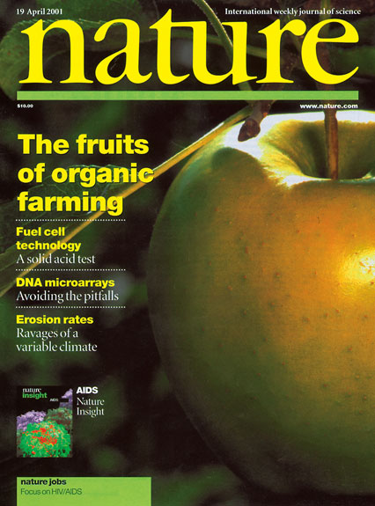
Scenario 4: Scholarly vs Popular Sources
Other times it can be trickier…
Notes:
-Monica

Slide 26
 | Journal - Scholarly | Magazine – Popular
Content | contain original research data | cover a wide range of popular interest topics, maybe with personal opinions and anecdotes
Author | a scholar with subject expertise | general public; an interested non-specialist
Audience | scholars, researchers, students | general public
Language | complex with specialized terminology | understandable to most readers
Reference | further research sources are cited | does not usually contain bibliographies
Notes:
-Monica
- you’ll have access to the pdf so you can refer back to this

Slide 27
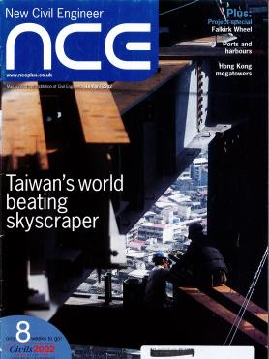
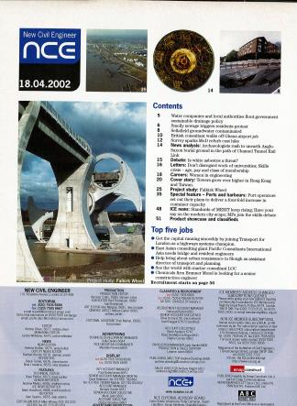
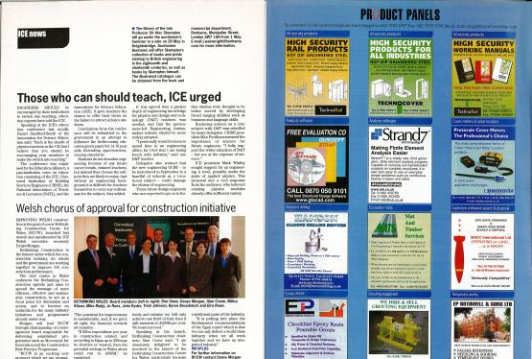
7
Notes:
Trade magazines (not peer reviewed)
First page has editorial board info with contact number, table of content.. Format looks like a regular magazine; inside might have advertisement info and current industry news..
Targeted audience are the professions in the field, for them to get current industry news and trends.
-Monica

Slide 28
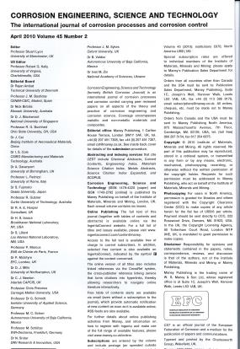
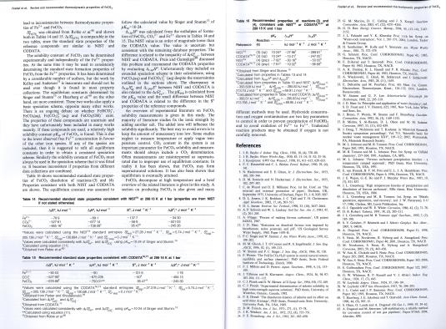
8
Notes:
Scholarly journals
First couple pages include editor’s info; their names and affiliation. (as well as author affiliation)
Text includes diagrams, tables, data, methodology and so on. Bibliographies or references in the end
Content is written for experts or scholars in the field, so the content is a bit hard to understand
Monica

Slide 29
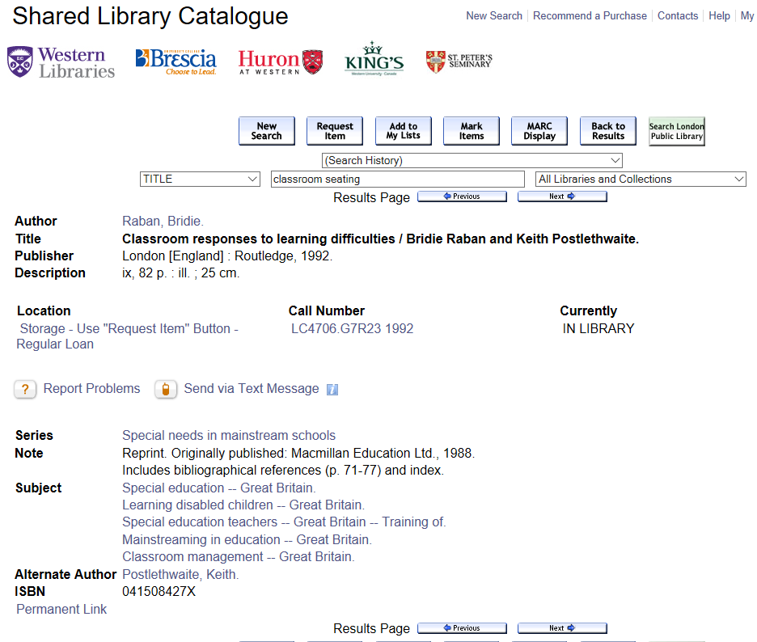
Scenario 5: How to get materials from other libraries
Notes:
As mentioned at the beginning, there are multiple libraries on campus. What’s more is that we have access to the collections at the affiliated colleges as well- and you can request any material be delivered to the library that is closest to you. We also regularly move books to storage to make room for new books and you can request these items from storage. You just need to use the request item button located in the record in the catalogue. Note that you can also request items from other people who have the books signed out- and this shortens the time that they have with the book and ensures that you’re next in line for the book.
ONLY guaranteed & DAYS of a book – can be recalled
-Monica

Slide 30
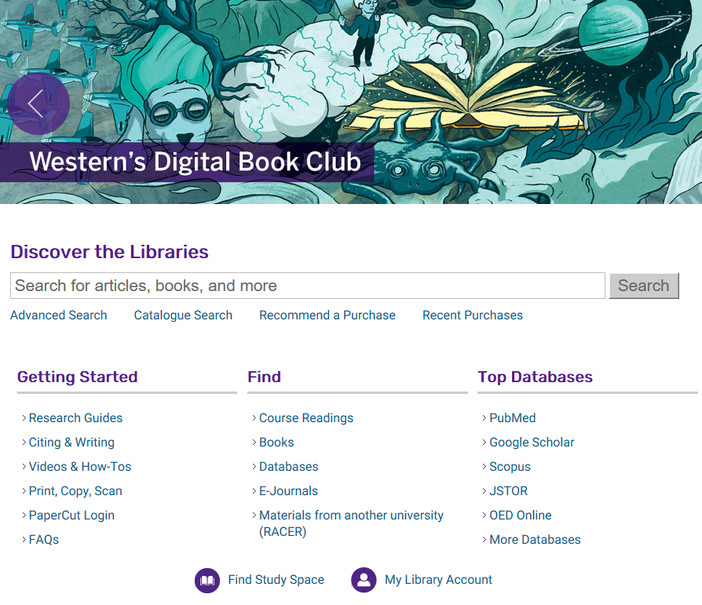
Scenario 5: How to get materials from other libraries
Notes:
Every once in a while…you might discover that the library doesn’t own a book or journal you need. Students can also request material that the library does not own and and we’ll get it from another university – it is free (if there is a charge – we ask first). You just need to create an account in RACER to make these kinds of requests. Has anyone used RACER before?
-Monica

Slide 31
Scenario 6: Citing
Notes:
Your professor likely will want you to use a specific citation style (often by discipline – APA, MLA, Chicago). Use the citation style your professor stated – for different courses you may use a different citation style.
-Monica

Slide 32
Scenario 6: Citing
A lot of databases have quick citing features
There are also tools that you could recommend students try such as Zotero or Mendeley- that will allow for really easy managing of sources and citing with appropriate style.
lib.uwo.ca
Notes:
Go and show them the page
-Monica

Slide 33
Questions?
Notes:
Please fill out 1 minute paper. If you would like question answered please include email
- Monica

