Slide 1
International Graduate Student Introduction to Western Libraries
Monica Fazekas & Shiyi Xie
Student Engagement and Outreach Librarian
Teaching and Learning Librarian
September 17, 2018
Notes:
Good afternoon everyone. Welcome to Western, to London ON and to Canada!
My name is Monica Fazekas and I’m the Student Engagement and Outreach librarian. I am Shiyi Xie, Teaching and Learning librarian for science and engineering and disciplinary coordinator for STEM. We’ve been asked here today to provide you with an introduction to the library system and its resources at Western.
-Monica

Slide 2
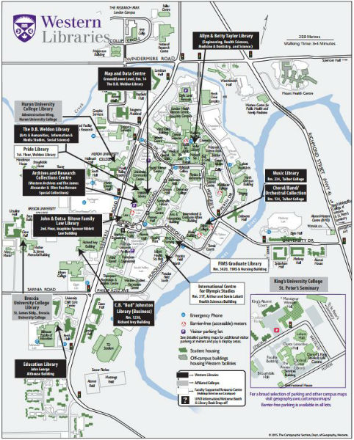
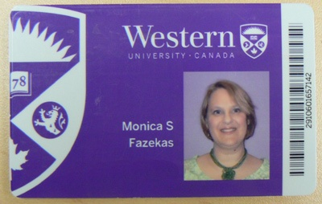
6 libraries + 3 affiliate libraries
Western Libraries’ locations and card
Notes:
One of your handouts has a map of libraries on one side and general contact information on the other side
On main campus there are 6 Libraries – organized by discipline
your Western One ID card is also your library card (same with your Western ID – username – and password) and your print/copy/scan card
-Never share your card or ID & password
You have access to ALL of the libraries on main campus, as well as the libraries of the 3 affiliated colleges – Huron UC, Brescia UC and Kings UC
-if you live in London – also have access to London Public Library – our library catalogue has a link which we will show you later)-
Monica

Slide 3
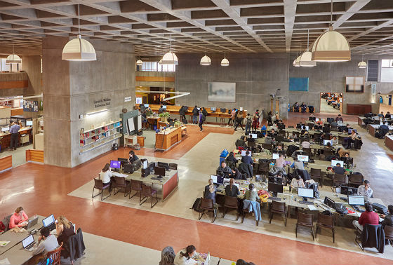
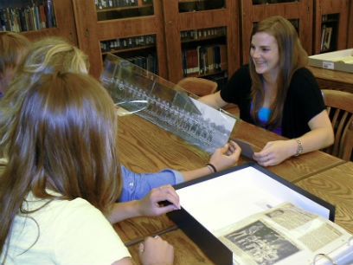
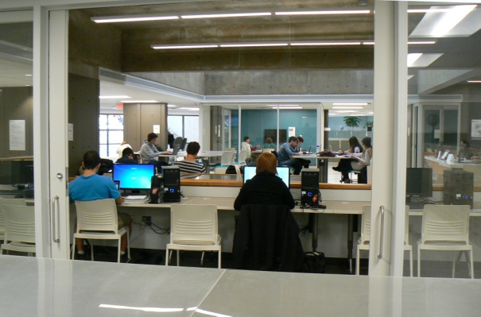
The D.B. Weldon Library
Arts & Humanities, Information
& Media Studies, Social Sciences
ARCC – Archives and Research Collections Centre
Map and Data Centre
Special Collections, Storage,
& University Archives
Located off of first floor of Weldon
Provides map, data, and GIS services
Located in the basement of Weldon
Notes:
The D.B. Weldon Library is the largest library. It supports Arts and Humanities, Information and Media Studies and the Social Sciences.
The Archives and Research Collections Centre (commonly referred to as the ARCC) houses Special Collections (rare books and materials), Regional Collections (local history), and the University Archives
The Map and Data Centre is located on the ground floor of Weldon and provides map, data and GIS (geographic information systems) and statistical services. GIS has cross-disciplinary applications being used in biology, civil engineering, earth sciences, geography, etc. The Centre provides access to GIS tools through workstations; it also supplies local, regional, national, and international data and imagery through various online spatial data directories. They offer research help and instruction on GIS information resources.
[GIS has cross-disciplinary applications and has been used in biology, civil engineering, earth sciences, geography, marketing, health science and more. GIS is a visual representation of data on a map. For example, GIS can illustrate service areas of health centres, locating all the coffee shops in London, or areas at risk of flooding. Within the Centre itself, they provide access to GIS tools through workstations that are equipped with ArcGIS, Google Earth Pro, and specialized statistical software; they also supply local, regional, national, and international data and imagery through various online spatial data directories. They offer instruction on GIS concepts and tools through one-on-one consultation, group workshops or virtual training; they can help you select the appropriate tools to use; and, provide direction in locating, obtaining, and integrating spatial datasets into your research.]
GIS Day will be on November 14th (workshops, presentations)
-Monica

Slide 4
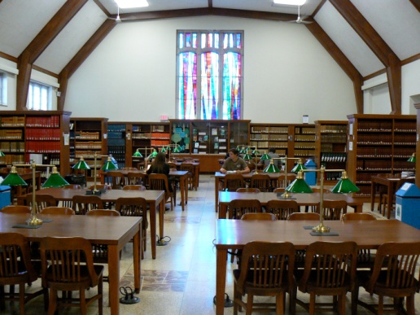
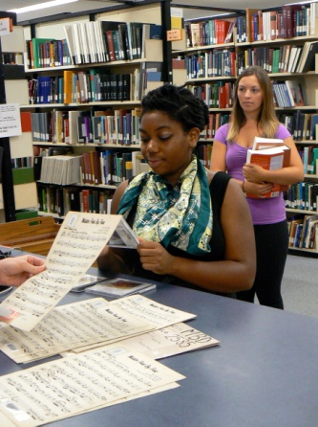
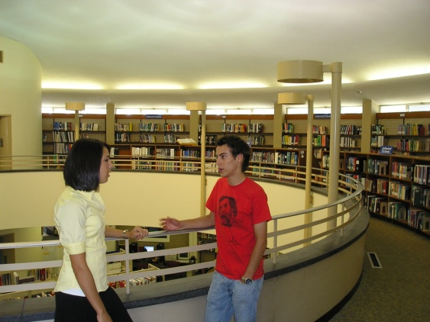
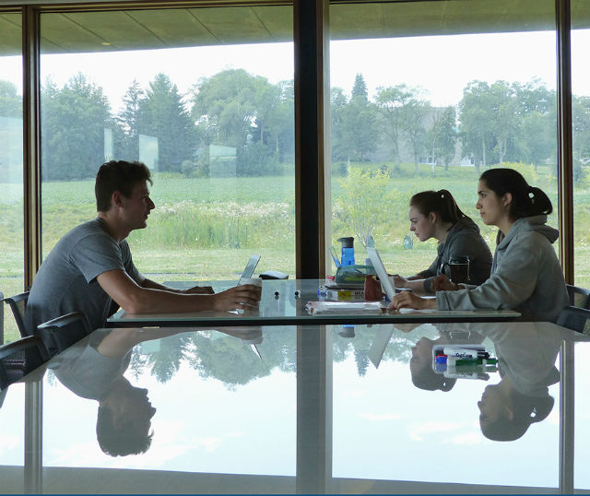
Allyn & Betty Taylor Library
John& Dotsa Bitove Family Law Library
Engineering, Science, Health Sciences, and Schulich School of Medicine & Dentistry
C.B. “Bud” Johnston Library (Business)
Music Library
Education Library
Notes:
The Allyn & Betty Taylor Library is the 2nd largest library on campus and it supports Engineering, Science, Health Sciences and the Schulich School of Medicine and Dentistry
-Although the primary user groups for the law, business, music and education libraries the are the students, faculty and staff of their associated faculties – these libraries and their resources (Business, Education, Music and Law) are open to everyone.
different libraries are busy at different times (e.g. during April exams the Business Library is fairly empty, so you can easily find a study space in there.)
-Monica

Slide 5
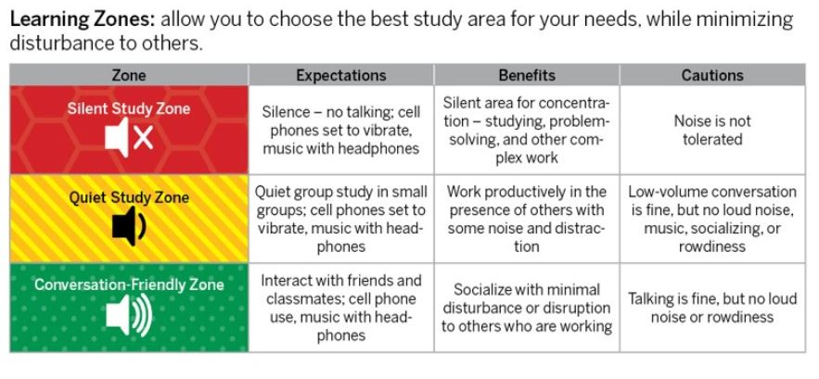
Learning Zones
Notes:
- Libraries have different study zones – Silent (no talking at all), Quiet (quiet small group discussions) & Conversation Friendly – can find maps with study zones online in in library
-most professional libraries are quiet study zone
– for Weldon –the higher you go the quieter; for Taylor – generally the lower you go the quieter
-Monica

Slide 6
Our collections...
Books, Journals, Multimedia (e.g. audio, video), Data sources, Music scores, Maps
Over 11 million items
Over $15 million spent annually to purchase and subscribe to library collections
Notes:
In 2017 we spent over 15 million dollars on library materials and subscriptions. We collect to support all of the different faculties and departments at Western and we collect a number of different formats. WLs has over 11 million items in our collection, which is a hybrid collection of both physical print and digital items.
Subscription based electronic sources require authentication if off campus: recognizes IP address while on campus, login when remote. (it will just pop up – type in your username and password (same as to access Western email).
- Monica

Slide 7
Library Website - Your Portal Visit us online anytime anywhere
lib.uwo.ca/
Notes:
Library website is your portal to information
Loan periods (120 days + 3 renewals), under services
Getting Started:
Course Readings – maybe on your OWL course site or library website
- “Videos and How Tos” - short 2 minute videos that explain how to do something - how to search, evaluate sources etc., how to cite in APA etc. – many are great to recommend to your students if you’re TAing a course
Find Study Space for room booking (media/collaborative tables) - – in Weldon daily study rooms on first come first serve basis
-There are also assigned research study rooms for academic and summer terms –must fill out application – based on need – deadline is today for application
My library account (never have fines! – can renew online), show - mine
Please remember: if you find resources you think that Western Libraries should own, please let us know and fill out the “Recommend a Purchase for Collection” form.
I can’t guarantee that we will be able to acquire it, but we will do our best
-Materials from another University - RACER (not overnight), recommend a purchase – almost always free – if charge we’ll get your approval 1st
Workshops (under Research Tools,)
Contacts (in person at desk, Chat, text, email, consultation with librarian (request through email)
-Monica

Slide 8
Scenarios
Finding article from citation
Finding Information
Research Guides and Databases
How to get materials from other libraries
Citation & Citation Management
Other ways we can help
Questions?
Notes:
We thought it might be helpful to work through some of the most common questions and problems that we hear from grad students
Shiyi

Slide 9
Finding article from citation
Kumar, S. A., Sridhar, K. & Kumar, G. V. 2018. Heat Transfer Analysis of Solar Air Heating System for Different Tilt Angles. Applied Solar Energy 54, (1): 17-22.
Notes:
Another common problem that students face is that they are told by their instructors to read Article XYZ and it’s available at the library. Well, what exactly does this mean? What multiple things COULD this mean? Any ideas? [let the students come up with some ideas- and try to find this…show them course readings, then show them how to search for an article in the library search…then show them how to find a print journal article (that’s where this one is).
Shiyi

Slide 10
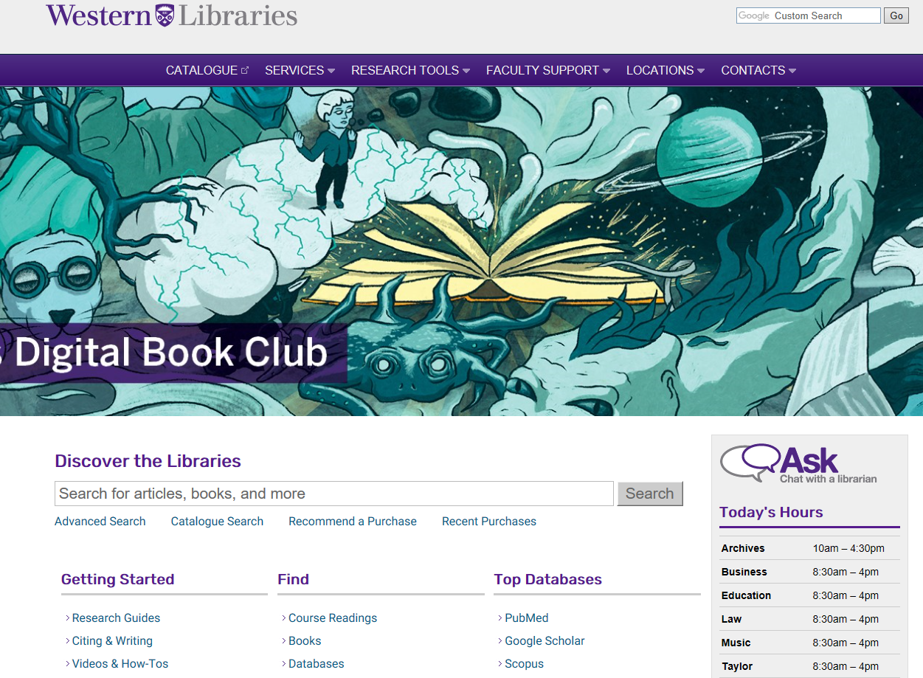
Catalogue Searching
Notes:
Shiyi

Slide 11
Notes:
Search journal title not journal article
-Shiyi

Slide 12
Your Turn! (2 min)
Do we have this article in print in the library?
Kumar, S. A., Sridhar, K. & Kumar, G. V. 2018. Heat Transfer Analysis of Solar Air Heating System for Different Tilt Angles. Applied Solar Energy 54, (1): 17-22.
Notes:
Shiyi

Slide 13
Finding Information
Notes:
Use the main search bar to find books, articles and more
Depending on discipline, you will likely be using specific databases to find your information ( can find out which database for that subject in Research Guides)
For very broad multidisciplinary research, the Main search bar can be helpful: it is a simple and fast search engine that will discover content from Western Libraries' vast collection of books, journal articles and other formats for virtually any topic using a single search box. The main search is a great place to start your research for both discipline specific and especially interdisciplinary subjects.
Search: green energy and environment
Show limits, books, journals, full-text, etc. date
- Shiyi

Slide 14
Finding Information
Extra functionality!

Slide 15
Cite
Email
Save
Notes:
These functions let you cite the item, email and save. Let’s take a closer look.

Slide 16
Your Turn! (4 min)
Run a search (green energy & the environment)
Limit the results to just books
Click on one or two books. Is it online or print?
Find a journal article
Next, try marking to save a result and email it to yourself.
Notes:
Come up with couple of examples

Slide 17
Finding Information – Research Guides & Databases
Research Guides
Lists reference tools, databases, and course guides specific to a particular subject.
There’s a Research Guide for every academic program at Western.
lib.uwo.ca
Notes:
This is a great tool to get to know the core resources in a particular subject area
Link out:
Since the guides are subject specific – the types of core resources (tabs across the top of the page) will be different across the various disciplines (show Ophthalmology [Clinical Tools] & Visual Arts [Images])
-– There will also be a mixture of print and electronic sources – which again will be discipline specific (based on how research is published for that particular field – e.g. we can’t order e-books if they are only available for purchase in print)
Show CBE Guide
-what other guides are relevant
-look up: (green energy and environment question)
Find database: multi-disciplinary : Web of Science or Scopus

Slide 18
Finding Information – Research Guides & Databases

Slide 19
Searching Databases - Web of Science
Notes:
So let them know about truncation, search terms , and “phrase search”

Slide 20
Searching Databases - Web of Science
Sorting results by citation counts
Access full-text article
Add limits
Notes:
Sorting and full text and limits on side-bar

Slide 21
Your turn! (4 Min)
Find Web of Science in Database List
Search green energy and environment
Use truncation and “phrase searching” in your search string
Sort by times cited
Notes:
-FYI – web of science is for all subjects including the humanities and social sciences
Times-cited (most cited papers first)
-Shiyi

Slide 22
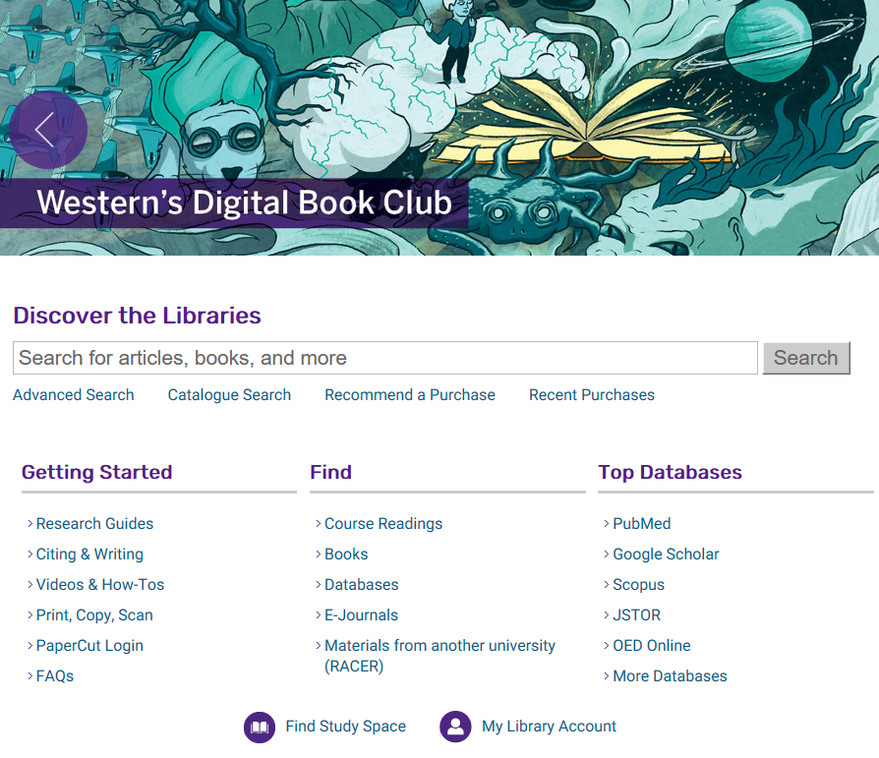
How to get materials from other libraries
Notes:
Every once in a while…you might discover that the library forgot to buy a book that you discover. Students can also request material that the library does not own and this is free and done through our interlibrary loans service using a tool called RACER. You just need to create an account to make these kinds of requests. Has anyone used RACER before? What can you tell us about your experience with it?
Show mine (if time can do – or stay and can help you get set up)
-Monica

Slide 23
Citation & Citation Management
Cite sources properly
Properly document what you read during your research process
Helps other researchers find sources
Use a citation management tool to help you keep track of your citations
lib.uwo.ca
Notes:
Help with paraphrasing – writing centre has gradwrite seminars, drop in help and a number of services
Use a citation management tool to help you keep track of your citations while doing your research (can upload directly from catalogue and databases, can manually insert, can organize into folders, automatically generates bibliography, endnotes, footnotes, or in-text citations BUT be sure to double check for accuracy.
Go to link:. There are different software packages available, each with its own strengths and weaknesses. Chart and quick start guides. – we don’t subscribe to any of the “full versions” but can help with these three free versions
Show Zotero (groups – D one) – show international authors – create bib – better when have downloads
-Monica

Slide 24
copyright.uwo.ca
Notes:
In both your teaching and research, you may have questions relating to copyright in Canada and how copyrighted works can be used here. In Canadian legislation there is a striving for a balance between the rights of creators/owners of copyright and the rights of users of these materials.
The website copyright.uwo.ca provides information and education on copyright for academic use.
The primary tool is the copyright decision map – use to determine whether particular use is an infringement or not
1st two questions determine if copyright even applies (e.g. public domain or insubstantial amount)
For protected material – 2nd two questions looks at licenses and exceptions that would allow copying
The last question navigates “when all else fails” securing permissions
Don’t worry about not knowing about Canadian copyright, there is help (Tom Adam, Copyright Librarian).
- Monica

Slide 25
Other ways we can help
Research help and consultations (e.g. systematic reviews)
Data and GIS support
Research metrics support
Post Print Hosting Platform
Journal Hosting System
Conference Management System
Notes:
-you can get help from service desks, Chat etc. , but for in-depth library research help you can set up a meeting with a librarian – use the email under contacts to get help.
Some departments have their own graduate student journal – if yours doesn’t and you are interested, come talk to us – we can help set one up for you (open access, can do full double blind peer review); Also have conference management system – e.g. if have faculty/departmental grad symposium – can do peer review through system and publish conference proceedings afterwards as well.
Monica

Slide 26
Questions?
Notes:
Please fill out one-minute paper. If you would like question answered please include email
- Monica

