Slide 1

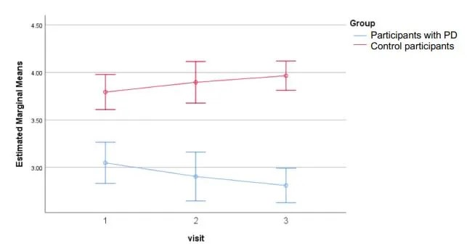
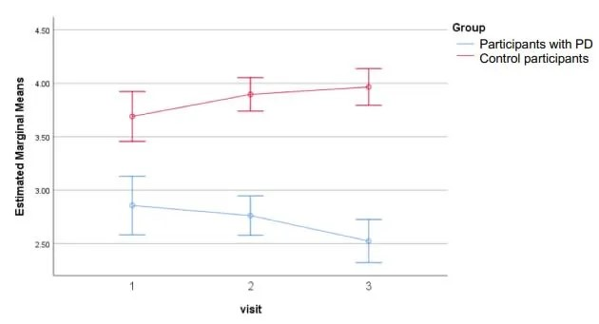
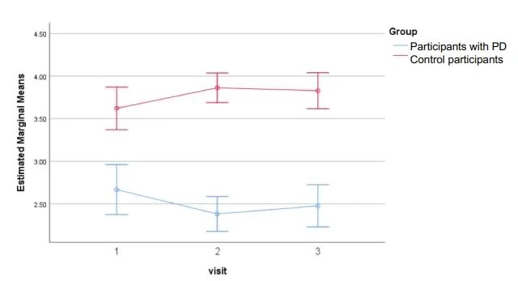
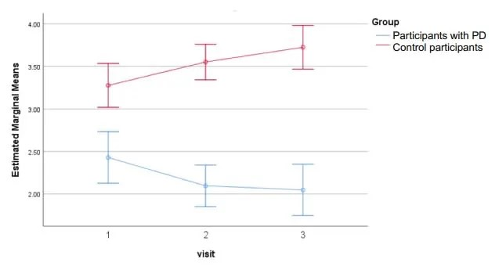
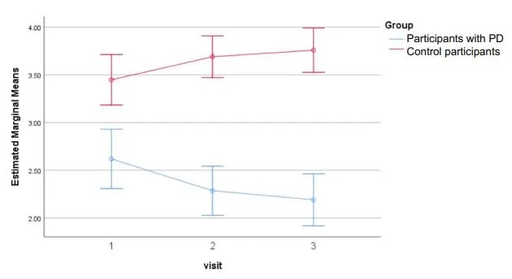
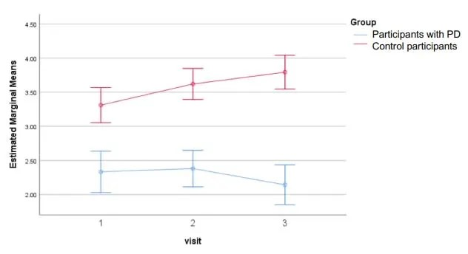
Communicative Effectiveness Survey (CES): A patient-reported outcome measure assessing perceived communicative effectiveness; validated for use in individuals with Parkinson’s disease (IWPD).³
Focus: Perceived effectiveness of communication across everyday speaking situations (e.g., conversations with family or friends, telephone use, communication in noisy environments).
Communicative Effectiveness Survey (CES): A patient-reported outcome measure assessing perceived communicative effectiveness; validated for use in individuals with Parkinson’s disease (IWPD).³
Focus: Perceived effectiveness of communication across everyday speaking situations (e.g., conversations with family or friends, telephone use, communication in noisy environments).
Communicative Effectiveness Survey (CES): A patient-reported outcome measure assessing perceived communicative effectiveness; validated for use in individuals with Parkinson’s disease (IWPD).³
Focus: Perceived effectiveness of communication across everyday speaking situations (e.g., conversations with family or friends, telephone use, communication in noisy environments).
Exploring the stability of communicative effectiveness
among individuals with hypophonia and Parkinson’s disease
A. Page, PhD^{1,2}, C. Mancinelli, PhD², J. Theurer, PhD^{1,2} , M. Jog, MD³, & S. Adams, PhD^{1,2,3}
¹School of Communication Sciences and Disorders, ²Health and Rehabilitation Sciences, ³Department of Clinical Neurological Sciences, Western University, London, ON, Canada
Introduction
Method
Results
Communicative participation is a key construct for understanding the broader impact of speech and voice disorders, including hypophonia associated with Parkinson’s disease (PD)¹.
Patient-reported outcome measures (PROMs) are central to patient-centred care because they capture individuals’ perceptions of how communication disorders affect their everyday lives².
The Communicative Effectiveness Survey (CES) is a participation-based PROM measuring perceived communicative effectiveness³.
The CES measures perceived effectiveness of communication across everyday speaking situations (e.g., conversations with friends or family, telephone use, communication in noisy environments)³ and is validated for use in individuals with Parkinson’s disease (IWPD)⁴.
Although used in clinical and research contexts, the stability of participation-based PROMS, including the CES, as a pre-post outcome measure is not well established ⁵.
Examining self-rated communicative effectiveness across repeated time points may therefore clarify the stability of this measure, inform preliminary test-retest properties of the CES, and support interpretation of participation-based PROMs in individuals with PD.
Patient-Reported Outcome Measure
Communicative Effectiveness Survey (CES)
A PROM designed to evaluate how effectively an individual feels they communicate in everyday situations.
Validated for use in IWPD⁴.
Aims to capture a speaker’s perceived communicative effectiveness across a range of common communication contexts (e.g., talking in quiet settings, in noise, with familiar versus unfamiliar listeners, on the telephone, or in groups)
Focuses on participation and real-world communication
Consists of 8 items, each describing a different everyday communication situation
For each item, respondents rate how effective their communication is using a 4-point Likert scale: 1 = Not at all effective to 4 = Very effective.
Item scores are summed to yield a total score ranging from 8 to 32.
Higher scores indicate greater perceived communicative effectiveness
The CES can be analyzed using the Total score or Individual item scores to identify context-specific communication challenges.
PD vs Control: Self-rated Communicative Effectiveness over 3 visits
Significant multivariate effect of Group, F(8, 41) = 14.54, p<.001, η²_{partial} =.663 but not Visit, F(16, 180) = 0.68, p = .810, η²_{partial} = .067.
Significant Group X Visit interaction, F(16, 180) = 2.90, p< .001, η²_{partial} = .131.
Subsequent univariate testing for individual CES questions revealed the following:
A significant univariate effect was found for Group for all eight CES questions and in each case IWPD had a lower marginal mean compared to controls (Table 1).
No significant univariate effect of Visit for any of the eight CES questions (Table 1).
Significant Group X Visit interactions for 6 of the 8 CES questions (Q1, Q2, Q4, Q5, Q6 and Q8), but not for CES questions 3 and 7 (Table 1).
Significant univariate Group X Visit interactions are presented visually (see Figures) with a corresponding summary of post-hoc analysis results.
Table 1. Statistical results related to the univariate analysis of the eight individual CES questions.
Protocol
This study was part of a larger study that measured the test-retest stability of several PROMs⁶
Participants with PD and control participants were seated in a quiet laboratory environment for all three experimental sessions.
Visit 1: Baseline
A hearing screening was conducted on all participants.
All participants completed the MoCA.
All participants completed the CES during this visit.
Visit 2: Two to Five days following baseline Visit 1
All participants completed the CES.
Visit 3: Four weeks following Visit 2
During this final visit, all participants completed the CES for a third time.
Since this study was part of a larger study, the presentation order of the PROMs was randomized across participants and visits. The presentation order was determined using www.randomizer.org⁷
CES Q1: Conversation with family/friend at home
CES Q2: Conversation with strangers (quiet)
CES Q4: Conversation with stranger (phone)
CES Q5: Conversation in noisy environment
Statistical Analyses
Analyses were conducted using SPSS Version 29.0
Interpretation of effect sizes was based on Cohen (1988)⁸ where: η²_{partial} = .01 (small effect); η²_{partial} = .06 (medium effect); η²_{partial} = .14 (large effect).
Level of significance used was p < 0.05 for all comparisons.
Bonferroni correction was applied to all post-hoc comparisons to control for the family-wise error rate.
A RM MANOVA evaluated differences in mean CES scores rated by PD and control participants over three separate visits.
CES Q6: Speaking to friend when emotional
CES Q8: Conversation at a distance
1
Purpose
Results
Post-hoc analyses of the univariate Group × Visit interactions showed divergent CES trajectories, with controls demonstrating increased ratings and the PD group showing decreased ratings from Visit 1 to Visit 3 across CES comparisons Qs 1,2,4,5,6,8 (p < .001–.033). From Visit 1 to Visit 2, this pattern was limited to CES questions 4, 5 and 6 (p = .003–.035), indicating group-specific changes in CES ratings over time.
This exploratory study evaluated the test-retest stability of the Communicative Effectiveness Survey, a patient-reported outcome measure, using self-ratings provided by individuals with PD and age-matched control participants across three non-intervention study visits spanning approximately one month.
Additional pairwise post-hoc analyses for each CES question with significant univariate Group X Visit interactions revealed a differential pattern of results between groups.
Control participants reported significantly increased CES ratings between Visit 1 and Visit 3 for five of the eight CES questions (Questions: 1,2,5,6,8) whereas IWPD reported relative stability in CES ratings for each question over the three study visits.
An exception was a decrease in CES ratings from Visit 1 to Visit 3 on CES Q2 (Conversation with strangers in quiet) for IWPD
See Table 2
Table 2. Post-hoc pairwise comparisons across visits for Control and PD participants on CES questions (only significant interactions are reported)
Conclusion
IWPD reported significantly lower communicative effectiveness scores than control participants on all CES items, with differences of approximately 1 point on the 4-point scale, consistent across the three non-intervention study visits.
CES ratings provided by IWPD remained relatively stable across the three study visits, providing preliminary evidence of temporal stability of the CES in this population.
In contrast, control participants demonstrated significant increases in CES ratings across visits, contributing to the observed Group x Visit interactions.
These findings enhance understanding of the CES’s stability over repeated administrations and offer important context for interpreting participation-based PROMs for individuals with Parkinson’s disease.
These findings highlight group-specific trajectories of self-reported communicative effectiveness and suggest that the CES is a promising tool for monitoring changes in communicative effectiveness over time and may be useful for detecting change following speech-language interventions in this clinical population.
Method
Participants
Participants with PD
23 participants (7 female, 16 male) with hypophonia and PD
Age range: 58-82 years (M = 69.48 years, SD = 5.57)
Diagnosis of idiopathic PD for a minimum of three years
All judged to have hypophonia associated with hypokinetic dysarthria by an experienced movement disorder neurologist (Author: M.J.) and speech-language pathologist (Author: S.A.)
Tested in an “on” medication state
Required to pass a 40 dB hearing screening at 500, 1000, and 2000 Hz
Required to have a MOCA score >21
Required to speak, read, and write English
Excluded if history of DBS
Excluded if receiving speech and/or language therapy services
Excluded if they had a positive history of speech, language, or neurological impairments, except those related to PD
Participants serving as Controls
30 participants (21 female, 9 male) without PD or without a positive history of speech, language, or neurological impairments
Age range: 55-82 years (M = 69.37 years, SD = 7.69)
Required to pass a 40 dB hearing screening at 500, 1000, and 2000 Hz
Required to have a MOCA score >26
Required to speak, read, and write English
CES | PD Marginal Mean | Control Marginal Mean | Univariate effect of Group | Univariate effect of Visit | Univariate Group X Visit Interaction
Q1 | M = 2.92, SD = 0.41 | M = 3.89, SD = 0.43 | F(1,48) = 67.63, p< .001, η²_{partial} = .528 | F(2,96) = 0.10, p = .901, η²_{partial} = .001 | F(2,96) = 4.06, p = .020, η²_{partial} = .060
Q2 | M = 2.71, SD = 0.41 | M = 3.85, SD = 0.43 | F(1,48) = 89.69, p< .001, η²_{partial} = .598 | F(2,96) = 0.71, p = .496, η²_{partial} = .035 | F(2,96) = 8.87, p< .001, η²_{partial} = .089
Q3 | M = 2.86, SD = 0.41 | M = 3.89, SD = 0.38 | F(1,48) = 82.13, p< .001, η²_{partial} = .556 | F(2,96) = 0.58, p = .563, η²_{partial} = .004 | F(2,96) = 2.61, p = .078, η²_{partial} = .034
Q4 | M = 2.51, SD = 0.46 | M = 3.77, SD = 0.48 | F(1,48) = 91.67, p< .001, η²_{partial} = .595 | F(2,96) = 0.07, p = .934, η²_{partial} = .007 | F(2,96) = 5.25, p = .007, η²_{partial} = .040
Q5 | M = 2.19, SD = 0.50 | M = 3.52, SD = 0.54 | F(1,48) = 78.29, p< .001, η²_{partial} = .569 | F(2,96) = 0.22, p = .807, η²_{partial} = .018 | F(2,96) = 10.17, p< .001, η²_{partial} = .095
Q6 | M = 2.37, SD = 0.46 | M = 3.63, SD = 0.48 | F(1,48) = 89.40, p< .001, η²_{partial} = .534 | F(2,96) = 0.16, p = .850, η²_{partial} = .004 | F(2,96) = 6.36, p = .003, η²_{partial} = .069
Q7 | M = 2.59, SD = 0.41 | M = 3.78, SD = 0.43 | F(1,48) = 98.29, p< .001, η²_{partial} = .587 | F(2,96) = 0.49, p = .617, η²_{partial} = .005 | F(2,96) = 1.38, p = .256, η²_{partial} = .018
Q8 | M = 2.29, SD = 0.55 | M = 3.58, SD = 0.54 | F(1,48) = 69.19, p< .001, η²_{partial} = .531 | F(2,96) = 2.14, p = .123, η²_{partial} = .042 | F(2,96) = 6.78, p = .002, η²_{partial} = .120
CES | Group | Visit 1 vs Visit 2 | Visit 1 vs Visit 3 | Visit 2 vs Visit 3
Q1. Conversation at home | Control | ns (.249) | ↑ (.036)* | ns (.249)
 | PD | ns (.377) | ns (.639) | ns (.771)
Q2. Strangers (quiet) | Control | ↑ (.050)* | ↑ (.015)** | ns (.483)
 | PD | ns (.747) | ↓ (.015)** | ns (.288)
Q4. Stranger (phone) | Control | ↑ (.050)* | ns (.096) | ns (.662)
 | PD | ns (.249) | ns (.771) | ns (.747)
Q5. Noisy environment | Control | ↑ (.050)* | ↑ (.003)** | ns (.288)
 | PD | ns (.168) | ns (.687) | ns (1.000)
Q6. Emotionally upset | Control | ns (.138) | ↑ (.039)* | ns (.978)
 | PD | ns (.558) | ns (.693) | ns (.803)
Q8. At a distance | Control | ↑ (.050)* | ↑ (.003)** | ns (.093)
 | PD | ns (.714) | ns (.418) | ns (.329)
References
Page, A. D., & Yorkston, K. (2022). Communicative participation in dysarthria: Perspectives for management. Brain Sciences, 12(4), 420.
Cohen, M.L. & Hula, W.D. (2020). Patient-reported outcomes and evidence-based practice in speech-language pathology. American Journal of Speech-Language Pathology, 29(1), 357 – 370.
Donovan, N.J., Velozo, C.A., & Rosenbek, J.C. (2007). The communicative effectiveness survey: investigating its item-level psychometric properties. Journal of Medical Speech-Language Pathology, 15(4), 433 – 447.
Donovan, N.J., Kendall, D.L., Young, M.E., & Rosenbek, J.C. (2008). The communicative effectiveness survey: preliminary evidence of construct validity. American Journal of Speech-Language Pathology, 17(4), 335 – 347.
Baylor, C., Linna Jin, J., Mach, H., & Britton, D. (2024). Communicative participation outcomes in individuals with PD receiving standard care speech-language therapy services in community settings. International Journal of Language & Communication Disorders, 59(2), 808–827.
Page, A.D., Mancinelli, C., Theurer, J., Jog, M., & Adams, S.G. (2025). Exploring the stability of communicative participation and level of daily speech usage among individuals with hypophonia and Parkinson’s disease. American Journal of Speech-Language Pathology, 34, 2425 – 2439.
Urbaniak, G.C., & Plous. (2013). Research Randomizer (Version 4.0) [Computer Software]. Retrieved from http://www.randomizer.org
Cohen, J. (1988). Statistical power analysis for the behavioral sciences. New York: Routledge Academic.
Note: Values represents Bonferroni-adjusted post-hoc pairwise (p values in parentheses). ↑ indicates a significant increase in CES score
↓ indicates a significant decrease. * p ≤ .05. ** p ≤ .01.

