Slide 1

Effects of Cerebello-Spinal Transcranial Pulsed Current Stimulation (tPCS) on Speech in Neurodegenerative Ataxia
Scott Adams^{1,2,3}, Jacky Ganguly³, Catie Johnson², Dorian Aur³,
and Mandar Jog³
¹ School of Communication Sciences & Disorders, ² Health & Rehab. Science, ³ Department of Clinical Neurological Sciences, Western University, London, Ontario, Canada
Conference on Motor Speech 2022

Slide 2
Background
Neurodegenerative ataxia represents a group of disabling diseases that include Spinocerebellar Ataxia (SCA), Multisystem Atrophy – Cerebellar type (MSA-C), Idiopathic Ataxia (IA), and other disorders.
Effective medical treatments for neurodegenerative ataxia are very limited.
Non-invasive brain stimulation has recently been proposed for the treatment of degenerative ataxia.
A beneficial effect of combined anodal cerebellar and cathodal spinal stimulation has been reported in a few previous studies.
However, the effect of transcranial stimulation on ataxic speech symptoms has not been reported.
Conference on Motor Speech 2022

Slide 3
Purpose
The purpose of the present study was to examine the effect of short-term transcranial pulsed stimulation (tPCS) of the cerebellum on perceived speech severity in a group of individuals with neurodegenerative ataxia.
Conference on Motor Speech 2022

Slide 4
Methods
Participants included 17 individuals with a degenerative ataxia:
9 Idiopathic Ataxia
3 Multisystem Atrophy – Cerebellar type
2 Spastic Paraplegia - type 7 (SPG7)
1 Spinocerebellar Ataxia type 3 (SCA3)
1 Spinocerebellar Ataxia type 6 (SCA6)
1 Cerebellar Ataxia with Neuropathy and Vestibular Areflexia Syndrome (CANVAS).
12 age-matched controls
Conference on Motor Speech 2022

Slide 5
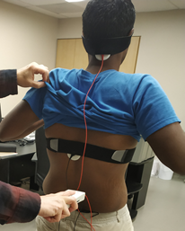
Methods
Participants were evaluated before and immediately after 20 minutes of tPCS.
The tPCS involved a fixed current intensity of 4mA, monophasic (unidirectional) waveform with a pulse duration of 1ms and a modulation frequency of 1Hz delivered via an anodal cerebellar electrode and a cathodal spinal electrode
Conference on Motor Speech 2022

Slide 6
Methods
The participants reading of the first two sentences of the rainbow passage were recorded and later presented to listeners for a rating of speech disorder severity using a visual analog scale (VAS).
Mild _____________________________________________________________ Severe Speech Disorder
Intrarater reliability = .84
Interrater reliability = .85
Conference on Motor Speech 2022

Slide 7
Results:
The listeners’ average VAS rating of the severity of the speech disorder for the post stimulation condition was significantly (p = .012) less than the pre stimulation condition.
Conference on Motor Speech 2022

Slide 8
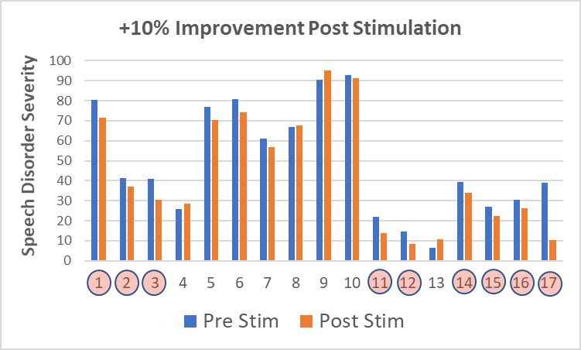
Results:
- 13 of the 17 ataxic participants showed an improvement in the VAS
rating of speech disorder severity following the tPCS stimulation.
- 9 of the 17 improved by more than 10%.
MSA
SCA3
MSA
Idiopathic
SCA6
MSA
Idiopathic
Idiopathic
SPG7
Idiopathic
SPG7
Idiopathic
Idiopathic
Idiopathic
CANVAS
Idiopathic
Idiopathic
Conference on Motor Speech 2022

Slide 9
Conclusions
These preliminary results suggest that short-term (20 minutes) cerebello-spinal transcranial pulsed stimulation (tPCS) can produce a transient improvement in the listener’s perception of the severity of the speech disorder in individuals with degenerative ataxia.
Additional long-term, sham controlled, tPCS studies are ongoing.
Conference on Motor Speech 2022

Slide 10
Effects of Cerebello-Spinal Transcranial Pulsed Current Stimulation (tPCS) on Speech in Neurodegenerative Ataxia
Scott Adams^{1,2,3}, Jacky Ganguly³, Catie Johnson², Dorian Aur³,
and Mandar Jog³
¹ School of Communication Sciences & Disorders, ² Health & Rehab. Science, ³ Department of Clinical Neurological Sciences, Western University, London, Ontario, Canada
Conference on Motor Speech 2022

