Slide 1

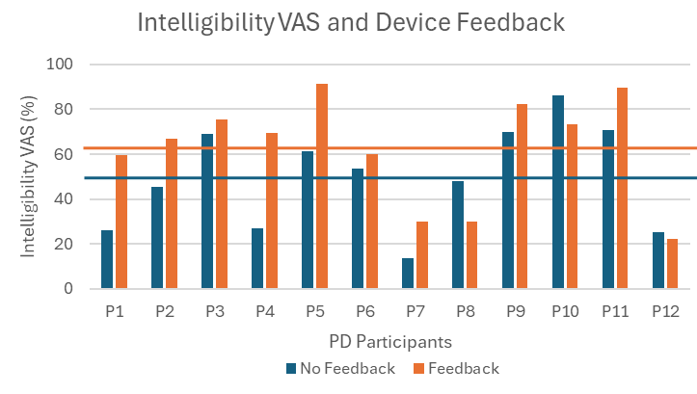
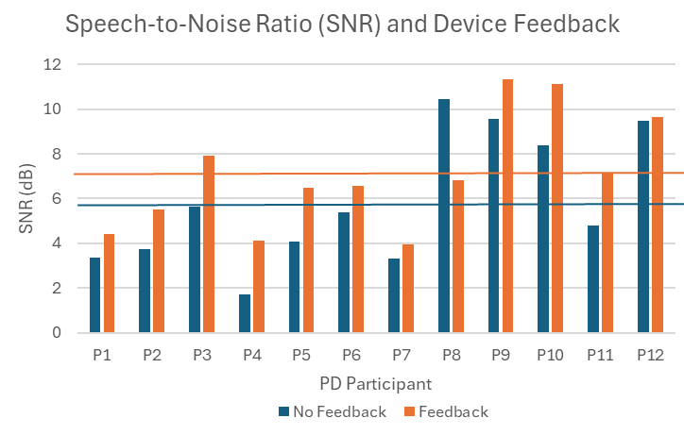
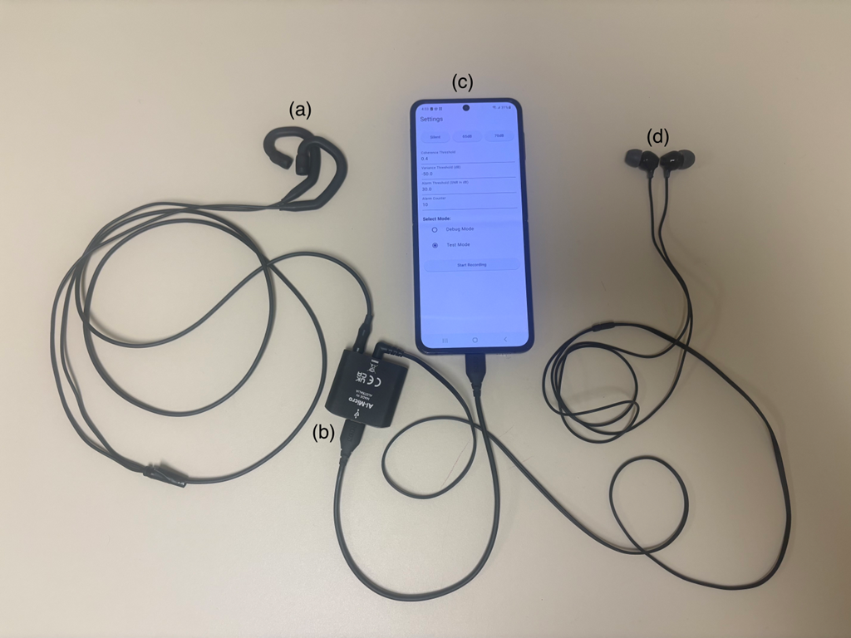
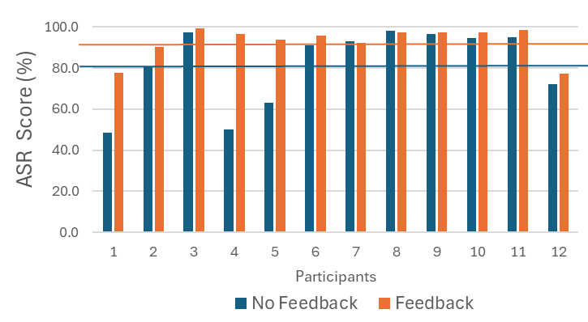
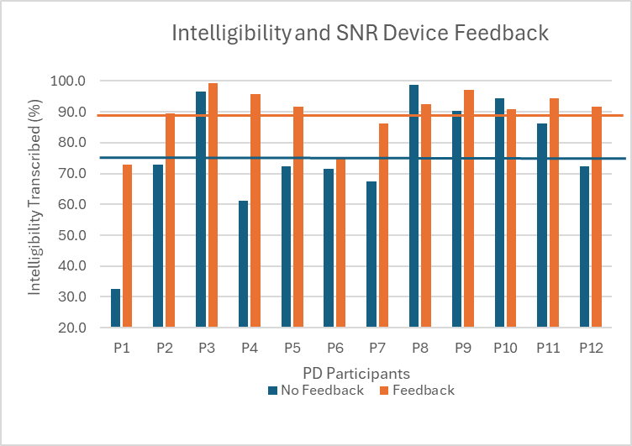

A Speech-to-Noise Feedback Device for Individuals with Hypophonia and Parkinson’s Disease
Scott Adams_{1,3}, Liwei Wang ₂, Daryn Cushnie-Sparrow₁, Mandar Jog ₃, and Vijay Parsa _{1,2}
¹ School of Communication Sciences & Disorders, ² Electrical & Computer Engineering, ³ Department of Clinical Neuroscience, Western University, London, Ontario, Canada
Introduction
Methods
Results
Results
Individuals with Parkinson’s disease (IWPD) and hypophonia often have difficulty communicating in background noise due to low speech-to-noise ratio (SNR) levels and associated reductions in speech intelligibility¹. For many IWPD, improvements in SNR and intelligibility can be achieved via clinician-based intensity feedback and cueing procedures. Unfortunately, the transfer and generalization of these treatment procedures to everyday conversations has been difficult to demonstrate in previous treatment outcome studies. To address this concern, we developed a portable speech-in-noise ratio feedback (SNF) device² to augment and support clinician-based treatment procedures. The purpose of the present study was to provide preliminary evidence about the effectiveness of an SNF device for improving SNR levels and intelligibility in IWPD and hypophonia talking in various background noise conditions.
Speech-to-Noise Ratio Feedback (SNF) Device:
We developed an assistive speech-to-noise ratio feedback
(SNF) system that estimates the user’s speech signal-to-noise ratio (SNR) in real-time and activates an audible alarm if the SNR falls below a predefined threshold (7dB used with all participants) and across a predefined time window (320ms used in the current study). The proposed SNF system is comprised of a pair of over-the-ear binaural microphones for audio data acquisition, and a mobile application (app) that implements the key algorithms for coherence-based own voice detection (OVD)^{5,} speech SNR estimation, and alarm triggering.
1. SNR Level: Effect of SNR Device Feedback
The SNR increased significantly by 1.3 dB (p = .02) when the feedback shifted from the off condition (M = 5.8dB) to the on condition (M = 7.1dB). SNR was affected by noise level (p < .001; higher SNR for 65dB than 70dB noise) but not by noise type (p = .07; similar SNR for Pink and Multi-talker).
Figure 3. Average SNR Level for No Feedback vs Feedback.
3. Intelligibility (VAS): Effect of SNR Feedback
The intelligibility score increased by 12.8% (p = .03) when the feedback shifted from the off to the on condition.
Figure 5. Average Intelligibility VAS and SNR Feedback.
1
Methods
4. ASR Intelligibility: Effect of SNR Feedback
The ASR intelligibility score increased by 11.1% (p = .03) when the feedback shifted from the off to the on condition.
Figure 6. Average ASR Intelligibility Score and SNR Feedback.
This study included 12 individuals with mild to moderate hypophonia and mild to moderate idiopathic PD. These IWPD included 9 men and 3 women aged 61-74 years (M = 67.6 years). Their conversational intensity was significantly lower (M= 65.7dB) than a comparison group of 15 healthy controls (71.7dB). Their average PD motor severity score (UPDRS III) score was 44/108 (range 24-59). The average number of years since diagnosis of PD was 8.8 years (range = 4-15 years). Participants were tested approximately 1 hour after their regularly scheduled anti-Parkinson levodopa medication. Their average levodopa equivalent daily dose (LEDD) was 858mg (range = 500-1100 mg). The average Montreal Cognitive Assessment (MoCA) score was 26/30 (range = 22-30). All participants passed hearing screening of 0.5, 1 & 2 kHz tones at 30dB. None of the IWPD had received surgical treatment for their PD.
The IWPD and hypophonia read aloud sentences from the Sentence Intelligibility Test (SIT) during 5 noise conditions (no noise, 65dB and 70dB of pink and multi-talker noise) with and without feedback from an SNF device. A pair of audio monitors (Yamaha HS8MP) were used to present the noise. An omni-directional microphone (AKG SE300B/CK92) at 1.2 meters was used to record the participant’s speech and background noise.
Six healthy young-adult listeners provided visual analogue scale (VAS) ratings and transcription-based measures of intelligibility. Automatic Speech Recognition (ASR) Intelligibility Scores were obtained via Whisper OpenAI large-v3-turbo³. SNR values were obtained using Praat software⁴ and hand measurements of mean intensity during sentences and non-speech noise segments. Three-way ANOVAs were used to examine the dependent measures (intelligibility and SNR).
2. Intelligibility (Transcribed): Effect of SNR Feedback
The intelligibility score increased by 13.4% (p = .008) when the feedback shifted from the off to the on condition. Intelligibility was affected by noise level (p = .016; higher for 65dB than 70dB noise), but not by noise type (p = .054; similar for Pink and Multi-talker).
Figure 4. Average Intelligibility Transcribed and SNR Feedback.
Figure 1. SNF Device with four main components: a) Sound Professionals SMS-EHB-2 binaural microphones; b) RØDE AI-Micro audio interface;
c) Android phone running the SNF app² ; d) In-ear headphones for feedback.
Conclusions
GitHub link for the
SNF App source code:
The provision of real-time feedback about a target SNR level via a mobile SNF device was associated with significant increases in SNR levels and intelligibility scores in a group of IWPD and hypophonia in a variety of background noise conditions. Future directions will include the evaluation of multiple and personalized threshold SNR targets in a variety of mobile conditions and naturalistic environments.
https://github.com/LarryWangCA/Speech_To_Noise_Ratio_Feedback
1. S. Adams, A. Dykstra, M. Jenkins, and M. Jog, “Speech-to-noise levels and conversational intelligibility in hypophonia and Parkinson’s disease,” J. Med. Speech-Lang. Pathology, vol. 16, no. 4, pp. 165–172, 2008.
2. L. Wang, S. Adams, and V. Parsa, “Development and Evaluation of a Speech-to-Noise Ratio Feedback System”, IEEE Engineering in Medicine and Biology Society. Annual International Conference, pp 1-6, 2025. DOI: 10.1109/EMBC58623.2025.11254250
3. A. Radford, J. W. Kim, T. Xu, G. Brockman, C. McLeavey, and I. Sutskever, “Robust speech recognition via large-scale weak supervision,”in Proc. 40th Int. Conf. Machine Learning (ICML)., Honolulu,HI, USA, Jul. 2023, pp. 28492–28518.
4. P. Boersma, “Praat, a system for doing phonetics by computer,” Glot Int., vol. 5, no. 9/10, pp. 341–345, 2001.
5. J. Bitzer, S. Bilert, and I. Holube, “Evaluation of binaural own voice detection (OVD) algorithms,” in Proc. 13th ITG-Symposium Speech Commun., Oldenburg, Germany, Oct. 10-12, 2018, pp. 1-5.
Figure 2. Three-page layout of the SNF Device application.

