Slide 1
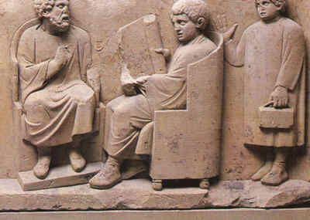
The Job Market in Classics by Randy Pogorzelski

Slide 2
Classics Departments and Careers
Graduate work in Classics, including both the MA and the PhD, does not aim to prepare you for any job except being a Classics professor, and most Classics graduate students will not become professors. It is not the goal of Classics departments to train our students for jobs.
That doesn’t mean that your professors don’t care about your future career. We want you to be happy, and for most people, being happy depends on having a job.
It also doesn’t mean that the skills you acquire and practice as a Classics graduate student will not be useful in your job search and in a variety of non-professor careers.

Slide 3
Some Wise Words from Claire Potter:
First, no one -- whether a department chair, a graduate adviser, a graduate student or a contingent faculty member -- should be dismissive about the value, availability and satisfactions of work in nonprofits, industry, government or secondary school teaching and academic administration. Yes, you may need some help from a career counselor to mount a successful search; yes, there may be geographical challenges. But the fact that other people you know have had difficulty pursuing careers that make good use of a humanities Ph.D., or that your own doctoral program discouraged you from even thinking that way, doesn’t mean such work isn’t available or that a doctorate in the humanities is not good preparation for it.
https://www.insidehighered.com/views/2017/10/16/why-adjuncts-should-quit-complaining-and-just-quit-essay

Slide 4
Some Wise Words from Claire Potter (continued):
It is. My own professional organization, the American Historical Association, funded by a grant from the Andrew W. Mellon Foundation, has established a program called Career Diversity for Historians, a robust set of initiatives aimed at expanding job horizons and opportunities. More importantly, despite what your graduate adviser told you, the tracks for such careers have already been laid by prior generations of historians. A 2013 report issued by the AHA followed 2,500 scholars and found slightly more than half in tenure track jobs at four-year colleges and universities; 17.8 percent in part-time, contingent or temporary jobs; and the rest in “a wide range of careers that included government, law firms, libraries and publishing houses.” Only two out of the 2,500 historians were confirmed unemployed, and 70 could not be located. “Even if we assume that all of the 70 Ph.D.s who could not be found are missing because they don’t have jobs, that’s an unemployment rate of about 3 percent,” the report concludes -- lower than the national unemployment rate in 2013 and now.

Slide 5
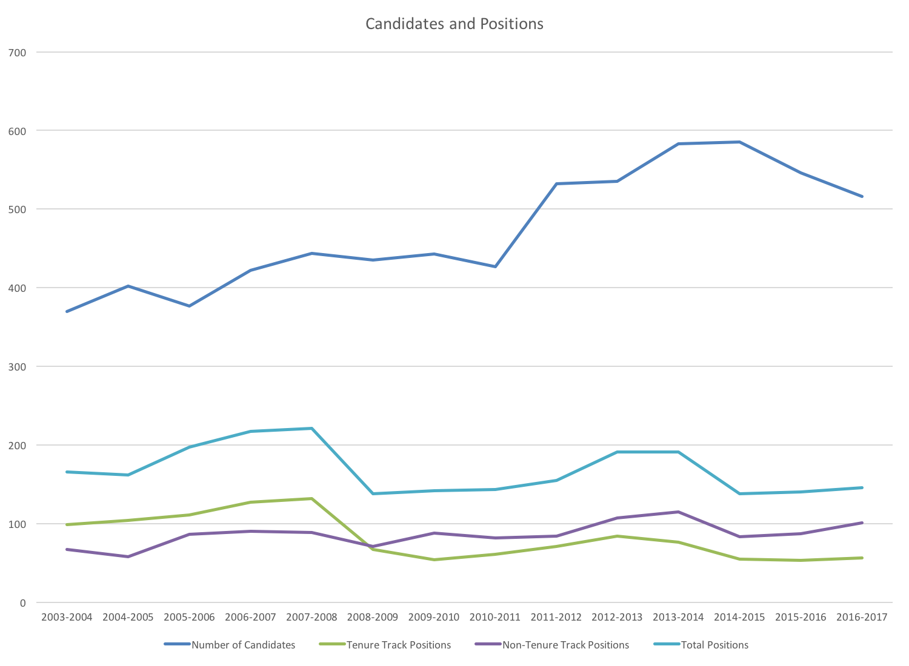

Slide 6
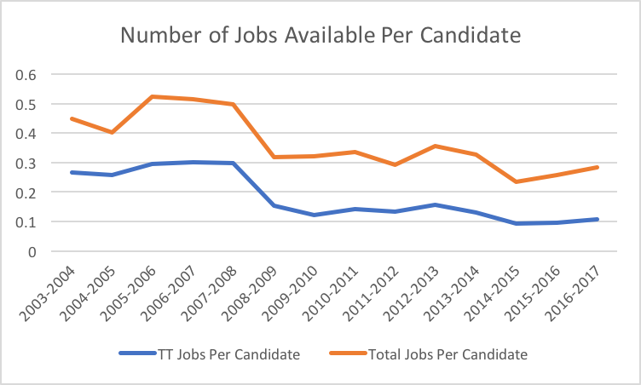

Slide 7
Academic Year | Number of Candidates | First-Time Candidates | Tenure Track Positions | Non-Tenure Track Positions | Total Positions
2003-2004 | 370 |  | 99 | 67 | 166
2004-2005 | 402 |  | 104 | 58 | 162
2005-2006 | 377 |  | 111 | 86 | 197
2006-2007 | 422 |  | 127 | 90 | 217
2007-2008 | 444 |  | 132 | 89 | 221
2008-2009 | 435 |  | 67 | 71 | 138
2009-2010 | 443 |  | 54 | 88 | 142
2010-2011 | 427 |  | 61 | 82 | 143
2011-2012 | 532 |  | 71 | 84 | 155
2012-2013 | 535 |  | 84 | 107 | 191
2013-2014 | 583 |  | 76 | 115 | 191
2014-2015 | 585 |  | 55 | 83 | 138
2015-2016 | 546 |  | 53 | 87 | 140
2016-2017 | 516 | 154 | 56 | 90 | 146
This data comes from the Society for Classical Studies Placement Service. You can find these numbers and more at:
https://classicalstudies.org/professional-matters/professional-matters-data-collection

Slide 8
Should you even do a PhD?
In Canada, only 55.8% of students who started a Ph.D. program in the humanities in 2001 finished their program, and of those who did finish, the average time to completion was 18.25 terms (just over 6 years). This is in spite of funding limits that mean it’s very difficult to get scholarships or any funding past year 4.
Although those statistics are for Canada only, the situation in the US, and around the world, is similar. Only about half of students who start a humanities PhD finish, and most take longer than is fundable.
http://www.universityaffairs.ca/features/feature-article/the-phd-is-in-need-of-revision/#latest_data
It’s not crazy to do a PhD, but start it with your eyes open. It’s uncertain you’ll finish, and it’s not a good pathway to a job. Still, even when it looked like I wasn’t going to get an academic job, I didn’t regret choosing to do a Ph.D.

Slide 9
What about the PhD program at Western?
Western’s PhD program in Classics enrolled its first students in 2009. We have enrolled a total of 18 students since then. Of those, 8 are still enrolled, 5 have left the program without graduating, and 5 have completed the degree.
Of the 5 Western Classics PhD graduates, 1 has a tenure track job, 3 have non tenure track jobs, and 1 stopped looking for academic work after two non tenure track jobs.
Of the 5 Western Classics PhD graduates, 1 finished in 4 years, 1 finished in under 5 years, and 3 finished in under 6 years. We have yet to have a student graduate after taking more than 6 years, but we do have 2 students who have been in the program longer than that.

Slide 10
Some Good News:
Liberal arts majors may start off slower than others when it comes to the postgraduate career path, but they close much of the salary and unemployment gap over time, a new report shows.
By their mid-50s, liberal arts majors with an advanced or undergraduate degree are on average making more money those who studied in professional and pre-professional fields, and are employed at similar rates. But that’s just one part of the paper’s overall argument that concerns about the value of a liberal arts degree “are unfounded and should be put to rest.”
“That’s a myth out there – that somehow if you major in humanities, you’re doomed to be unemployed for the rest of your life. This suggests otherwise,” said Debra Humphreys, a co-author of the report and vice president for policy and public engagement at the Association of American Colleges and Universities. “That sort of journey to professional success is more of a marathon than a sprint.”

Slide 11
Some Good News (continued):
At peak earning ages (56-60), graduates with a baccalaureate degree in a humanities or social science field are making $40,000 more than they were as recent graduates (21-25). And while in the years following graduation they earn $5,000 less than people with professional or pre-professional degrees, liberal arts majors earn $2,000 more at peak earning ages, when they make about $66,000. (Salaries in both fields still lag behind engineering and math and sciences graduates, who in their late 50s make about $98,000 and $87,000, respectively.)
Liberal arts graduates don’t fare quite as well when they possess just an undergraduate degree, though. The workers with advanced degrees in any field of study – who make up about 40 percent of all liberal arts graduates, and earn about $20,000 a year more for it -- push the earnings averages up significantly.
https://www.insidehighered.com/news/2014/01/22/see-how-liberal-arts-grads-really-fare-report-examines-long-term-data

Slide 12
Resources for thinking about jobs outside of university Classics:
Kyle Johnson’s Guide:
http://kyle-p-johnson.com/blog/2017/09/05/affable-guide-leaving-classics.html
The SCS panel on related careers
https://classicalstudies.org/placement-service/related-careers
The Legion Project
http://www.paideiainstitute.org/legion
An announcement of the Legion Project
https://eidolon.pub/classicists-your-name-is-legion-a633f8897b0a
An analysis of the results of the Legion Project
https://eidolon.pub/ne-plus-ultra-classics-beyond-the-tenure-track-1504c555f20b

Slide 13
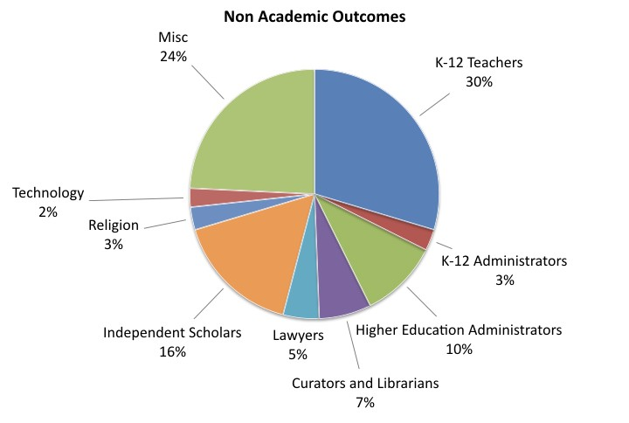
https://eidolon.pub/ne-plus-ultra-classics-beyond-the-tenure-track-1504c555f20b

Slide 14
Our last big survey of Western Classics MA and PhD alumni was in 2014 (thanks to Kyle for making this list):
74 not still students; info for 46
PSE
Tenure track x6 (~1/8)
Non-tenure track x9
staff x3 (academic advisor, e-learning developer, postdoctoral services)
Secondary/vocational education x10 (incl. Latin x3)
Editing/publishing x5
Librarian x2
Government x2, Law, Real estate, Management x2 (sports executive)
Tarot card reader, wine & spirits, edible and organic landscape design
legal decision writer, city planner
Notes:
YOU will get a job

Slide 15
Resources for thinking about Classics professor jobs:
The best reading for any graduate student thinking about a Classics career is Joy Connolly’s job market guide:
https://sites.google.com/a/nyu.edu/jconnolly/home/job-market-handbook
You should also look at the SCS Placement Service “Advice for Candidates”:
https://classicalstudies.org/placement/advice-candidates
I’m not sure I really recommend it, but there’s a site dedicated to anonymous venting about the Classics job market:
http://famaevolent.blogspot.ca

Slide 16
So you want to be a professor…
Here are some things you can do to improve your chances on the job market (in no particular order):
Join the CAC and the SCS/AIA, and maybe go to an SCS/AIA meeting once before you’re on the market. Going to a meeting can be expensive, so it might not be worth it until you’re actually on the market, but at least joining the society is pretty cheap for graduate students. Remember also to sign up for the placement service when you’re on the market.
Present at conferences. It helps a lot to be accustomed to presenting your work and answering questions, plus these are great for building a CV. Pick good titles for your papers, since these are what people will see on your CV. Think in particular about presenting at the CAC or SCS/AIA, or maybe try CAMWS. You might also think about presenting in our departmental seminar series.

Slide 17
Write an article. Be careful about this one because once something is in print you can’t take it back. Talk with your advisor, but it is a good idea to try to have an article at least under consideration at a good journal when you’re applying for jobs. This can be a modified dissertation chapter or something else. One other note about this—you’re not going to be a prolific article writer at this stage, so don’t waste your best material on a substandard venue.
Get some teaching experience. The best thing would be to get assigned your own class to teach, but that’s not always possible. When you have the opportunity as a TA to contribute to teaching, you should take it. You should also have your advisor or other recommenders observe your teaching so that they can write an evaluation for your teaching portfolio or at least include this in the letter of recommendation.

Slide 18
Be a good departmental citizen. Remember that search committees are looking for someone to be a colleague, and you want your recommenders and all the members of the department (who may be informally asked about you) to think of you as a good colleague. This means being friendly, helpful, and doing good work. Show up on time, stay until the end, and if you can’t make it to class, a talk, or other obligation, send an apology email (in advance, if possible).
Be proactive, committed, and driven. Too often the state of the market leads students to act diffident. If you want to be a professor, talk to your professors about that goal and make sure you inform yourself about what you can do, especially during the ABD stage. The best candidates don’t need to be told to do things. Make your Classics work your top priority, and be willing to sacrifice for it despite the uncertainty of the outcome.

Slide 19
Think in advance about your job market plan and timeline so that everything comes together at the right time. It takes a while to get your application materials together, including especially a writing sample and job talk, not to mention lining up three recommendation letters in plenty of time. Be close enough to finished when you apply that you don’t let your applications get in the way of finishing your dissertation. Use the summer before you’re applying for jobs to make sure you have what you need. That includes signing up for the SCS placement service and knowing where to find ads for jobs when they come out.
Read Joy Connolly’s guide now. It will tell you about the practicalities of applying for jobs, and it will give you good advice for every stage of graduate school. https://sites.google.com/a/nyu.edu/jconnolly/home/job-market-handbook

