Slide 1

Notes:
Main Page

Slide 2

Intent to Register
February 25th to March 31st
Telephone: 519-661-3043
Fax: 519-850-2376
www.uwo.ca/arts
Notes:
Intro Title Page

Slide 3
What’s your module?
Get the information you need and submit your Intent to Register Form online via your student center account by March 31, 2026.
Intent to Register
Notes:
Typical Page

Slide 4
Step 1
View the online Academic Calendar at www.westerncalendar.uwo.ca
Step 2
Attend the ITR Fair in Mustang Lounge on March 18th and 19th, and attend Departmental Advising Sessions – see the schedule online at www.uwo.ca/arts
Step 3
Review Calendar
Degree Requirements
Module Requirements
Course Choices
Step 4
Submit an Online* ITR by March 31
Start Early! You may revise your online ITR until March 31.
In May and June, Departments will check eligibility for requested choices (Adjudication)
Check your report comments, and degree & module eligibility via student.uwo.ca
*Please note: Some students must submit a paper ITR form. For those few exceptions, please visit www.uwo.ca/arts/counselling/registration/intent_to_register/index.html
Intent to Register

Slide 5
What happens next?
Online registration appointment dates and priorities are determined.
Register for courses via student.uwo.ca during the summer.
Intent to Register

Slide 6
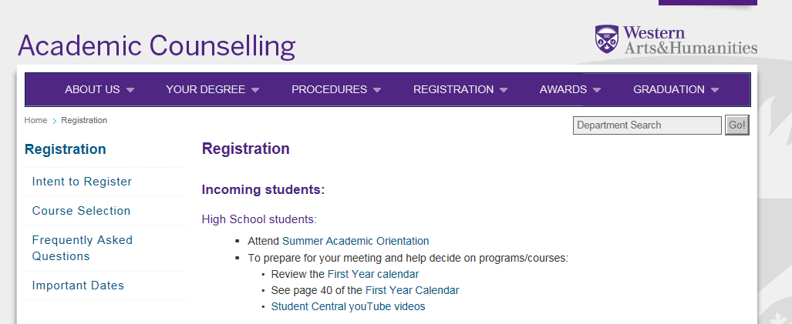
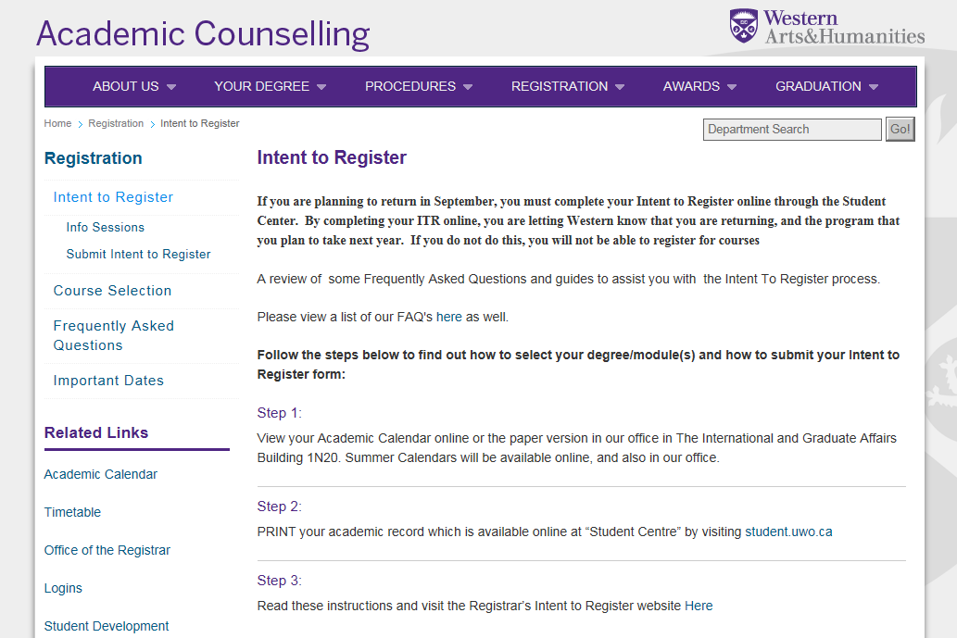
Online ITR (http://www.uwo.ca/arts/counselling)
Intent to Register

Slide 7
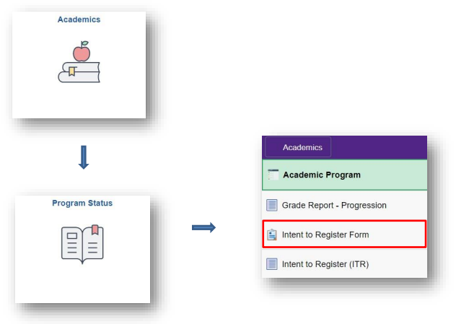
How to use the Online ITR
Visit student.uwo.ca. Select the “Academics” tile followed by the “Program Status” tile.
Intent to Register

Slide 8
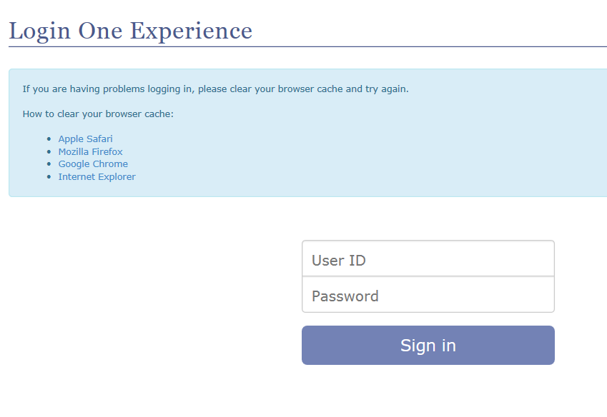
2) Select the “Intent to Register Form.” Log in to Western One Experience.

Slide 9
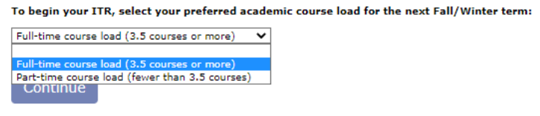
3) Select either full-time or part-time studies:

Slide 10
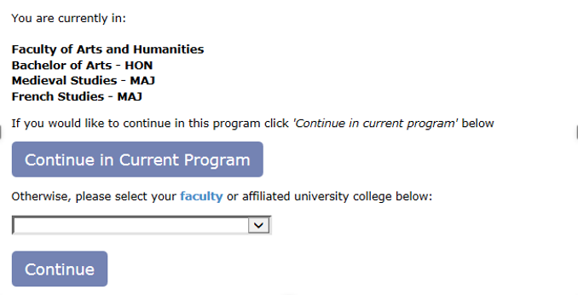
4) Review your current program and indicate if you would like to “Continue in Current Program” or “Change your Program/Module(s).
5) If you would like to change your Program/Module(s), select a Faculty or Affiliated University College and click ‘continue’.
Please note: “Brescia Program” will not be available to students not already registered in a Brescia program or module. If you have chosen to Continue in Current Program, you have completed your Intent to Register. However, you are given the option of Selecting a 2nd Choice. Follow the next steps if you choose to submit a 2nd choice
Intent to Register

Slide 11
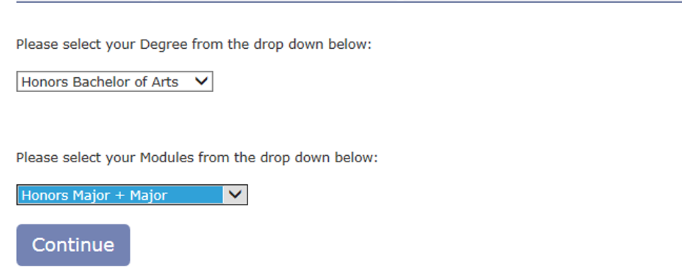
Select your degree type and module(s) type, and click ‘continue’:
Intent to Register

Slide 12
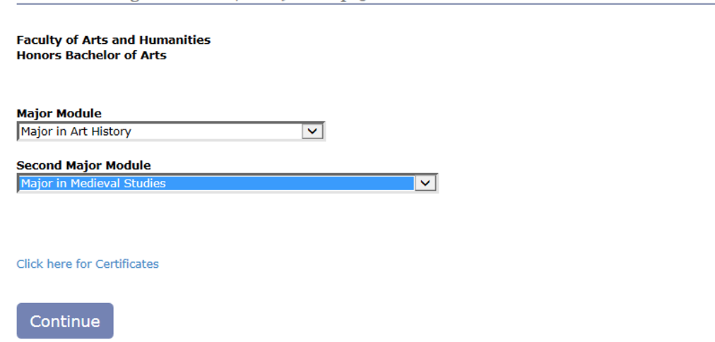
Select your preferred module(s) and certificate (optional), click ‘continue’
* If you would like to declare a certificate, please select “Click here for Certificate”.
Intent to Register

Slide 13
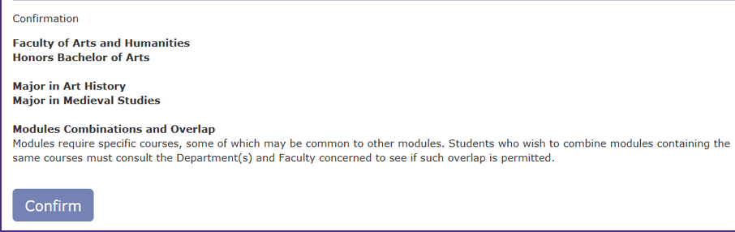
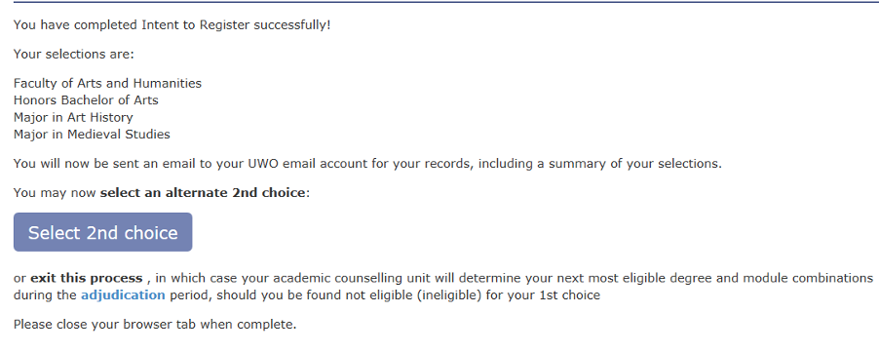
Confirm your selection, and click ‘continue’
To submit a 2nd Choice, click Select 2nd choice. Alternatively, close your browser tab when complete.
Intent to Register

Slide 14
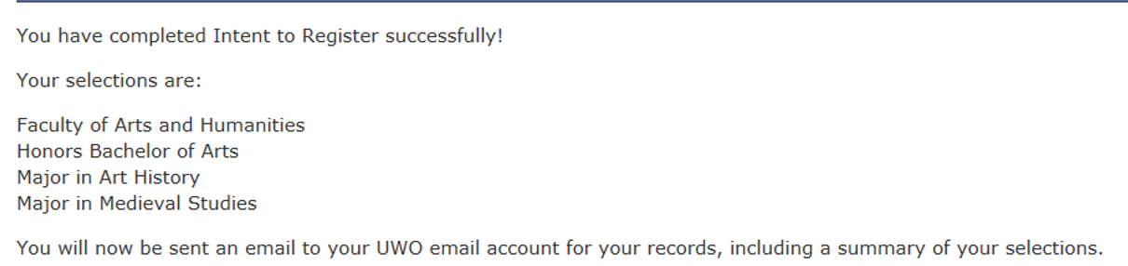
9) Check your Western email account for your Intent to Register
confirmation.

Slide 15
No Online ITR
The following students need to contact an Academic Counsellor to submit an ITR https://www.uwo.ca/arts/counselling/about_us/location.html
New SASAH students: Continuing SASAH students can do online ITR.
New Concurrent Degree students: Continuing Concurrent students can do online ITR.
Re-registrants: Students not currently registered this year but eligible to return to Western.
All Second-Degree Students: Continuing Second Degree students can do online ITR.
New Scholar’s Electives Students: Senior Scholar’s Electives Students can do online ITR.
New Cross-Disciplinary Degree students: Continuing Cross-Disciplinary students can do online ITR
Post-Degree Module students
New Western Scholars: Continuing Western Scholars can do online ITR
Intent to Register

Slide 16
Arts & Humanities
Departments & Programs
          Classical Studies
          English and Writing Studies (includes Film Studies)
          French Studies
          Linguistics
          Languages and Cultures
          Philosophy
          Visual Arts
          Gender, Sexuality, and Women’s Studies (includes Black Studies)
Faculty Modules:
          Major in SASAH
          Major in Creative Arts and Production
          Major in Medieval Studies
          Minor in Medieval Studies
Intent to Register

Slide 17
Certificates Offered
(completed concurrently with degree):
        Certificate in Ethics
        Certificat de français pratique
        Certificate in German
        Certificate in Italian
        Certificate in Spanish
        Certificate in Professional Communication
        Certificate in Theatre Arts
        Certificate in Writing
Intent to Register

Slide 18
Degrees Offered
Honors Bachelor Degree 4-Year
    (Honors Specialization or Double Major)
Bachelor of Fine Arts Degree 4-Year
    (Honors Specialization Studio Arts only)
Bachelor Degree 4-Year
    (Specialization or Major)
Bachelor Degree 3-Year
    (Major or Double Minor)
Intent to Register

Slide 19
Common to all degrees:
Essential modules
First-year requirements
Breadth requirements (Categories A, B, & C)
  Category A – 1.0 course from faculties of Social Science, Information and Media Studies, or Music
  Category B – 1.0 course from Arts and Humanities
  Category C – 1.0 course from the Faculty of Science
Essay requirements
Limit on the number of courses completed in one subject
Limit on the number of first-year courses (maximum of 7.0) that may count towards your degree.
Intent to Register

Slide 20
What’s Your Module?
Not sure?
What are your interests and strengths?
Check the course descriptions in the calendar online or visit the departmental website to view full syllabi.
Look at assigned course textbooks in the Bookstore.
Attend departmental counselling sessions or contact the department with your questions.
Talk about your options with your Academic Counsellor.
Which courses are you enjoying most this year?
Contact the Careers & Experience office http://careerexperience.uwo.ca/
Intent to Register

Slide 21
First Year
5.0 courses numbered 1000 – 1999
1.0 course from another Faculty (Category A) or a
Science (Category C)
Now, with the first 5 choices, you can start to build your degree.
Psychology
1002
and 1003
Film
Studies
1022
Philosophy
1020
Classical Studies 1000
English 1022E
Geology
020
Intent to Register

Slide 22
Two Ways to do Each Degree:
Honors Bachelor of Arts Degree (20.0 courses):
  Honors Specialization Module – concentration in one subject
  Examples: Honors Specialization in Film Studies
Honors Specialization in Philosophy
  Double Major Modules – two equal interests.
  Examples: Majors in French and Spanish
Majors in English and History
Four-Year Bachelor of Arts Degree (20.0 courses):
  Specialization Module – not as intensive as the Honors Specialization module
  Examples: Specialization in Gender, Sexuality, and Women’s Studies
  Specialization in Visual Arts
  Major Module – lots of variety – space for many optional courses
  Examples: Major in Art History and Studio Art
  Major in French Studies
Three-Year Bachelor of Arts Degree (15.0 courses):
  Major Module
    Examples: Major in Classical Studies
    Major in Linguistics
  Double Minor Modules
  Examples: Minor in Medieval Studies and Minor in German
  Minor in English for Teachers and Minor in Biology
Intent to Register

Slide 23
Honors Bachelor Degree (4-Year) 20.0 Courses
Honors Specialization
Double Major
Year
IV
Year
III
Year II
Year
IV
Year
III
Year II
Spanish
Spanish
Option
English
English
English
Option
Option
French
French
English
French
French
Spanish
Spanish
Option
English
English
English
Option
Category
C
Category
C
Astro. 1021
Spanish
Spanish
Astro.
1021
English
English
English
Option
French
French
Year
I
Category
A
Year
I
Category
A
English
1022E
Classical Studies
1000
French
1910
GSWS 1020E
History
1401E
Philosophy 1020
French
1900E
Spanish
1030
Film
1022
Sociology
1020
1.0 course from Category A (Other Faculty such as Social Science, MIT, Music…etc.)
1.0 course from Category C (Science)
2.0 designated essay courses (suffix F/G, or E), including 1.0 numbered 2000 or above
Maximum of 7.0 first-year courses (1000-1999)
Intent to Register

Slide 24
Honors Bachelor Degree (4-Year) 20.0 Courses
Specialization
Major
Visual Arts
Visual
Arts
Visual
Arts
Option
Option
GSWS
GSWS
Option
Option
Option
Visual
Arts
Visual
Arts
Visual
Arts
Option
Option
GSWS
GSWS
Option
Option
Option
ActSci
2053
Category
C
Category
C
ActSci
2053
Visual
Arts
Visual
Arts
Visual
Arts
Option
GSWS
GSWS
Option
Option
Art History 1641 &1643
Studio Art 1601
GSWS
1020E*
Category
A
Italian
1030
English
1020E
Sociology
1021E
Phil
1200
Greek
1000
English
1020E
English
1020E
1.0 course from Category A (Other Faculty such as Social Science, MIT, Music…etc.)
1.0 course from Category C (Science)
2.0 designated essay courses (suffix F/G, or E), including 1.0 numbered 2000 or above
Maximum of 7.0 first-year courses (1000-1999)
Intent to Register

Slide 25
Bachelor Degree (3-Year) 15.0 Courses
Major
Double Minor
Year
III
Year II
Year
III
Year II
English
English
Film
Film
Option
Phil.
Phil.
Phil.
Option
Option
Category
C
Category
C
Phil.
Phil.
Phil.
Physics
1021
English
English
Film
Film
Physics
1021
Option
Category
A
Anthro
1020E
Year
I
Visual Arts
Studio 1020
Year
I
Classical Studies 1000
Category
A
German
1030
Latin
1000
Philosophy
1020
History
1403E
French 1010
English 1020E
Film 1022
Group A
1.0 course from Category A (Other Faculty such as Social Science, MIT, Music…etc.)
1.0 course from Category C (Science)
2.0 designated essay courses (suffix F/G, or E), including 1.0 numbered 2000 or above
Maximum of 7.0 first-year courses (1000-1999)
Intent to Register

Slide 26
Academic Standing Status
Level 1 Progression
In Good Standing | ≥ 55%
On Probation | 50 – 54%
Required to Withdraw | < 50%
Level 2 Progression
In Good Standing | ≥ 60%
On Probation | 55 – 59%
Required to Withdraw | < 55%
Honors Progression | 70%
Dean’s Honor List | 80%
Intent to Register

Slide 27
Definitions
Prerequisite
  A course that must be successfully completed prior to registration for credit in the desired course.
Corequisite
  A course that must be taken concurrently with (or prior to registration in) the desired course.
Antirequisite
  Courses that overlap sufficiently in course content that both cannot be taken for credit.
Courses
  Unless otherwise noted "course", "option", or "full-course equivalent" means one full course or two half-courses (1.0 course).
Essay Course
  Courses with a significant writing component that is designated E or F/G.
Principal Course
  Specific first year courses that determine your eligibility for modules.
Modules
  Set of courses required for degrees (e.g. Major, Minor)
Subsidiary/Option
  Elective or optional subject within an honors program.
Intent to Register

Slide 28
Course Numbering
1000-1999 – First-year courses
2000-4999 – Senior courses
A/B – first term/second term non-essay half-course (0.5)
Y – half-course offered in other than a regular session
E – essay full course (1.0)
F/G – first term/second term essay half-course (0.5)
W/X – first term/second term full-course offered in one term (1.0)
Intent to Register

Slide 29
Tips
First year requirements
    You must complete any missing year 1 courses at your next registration.
Affiliated College Courses
    Maximum of 1.0 course at an affiliated college, if it is not offered on main campus.
Special Permission
    Consult the Department concerned to request permission
    (i.e.: waive prerequisite)
Course Load
    Maximum of 5.0 courses. Maximum of 5 per term.
Repeats
    Maximum 1 repeat of a passed course; 2 repeats of a failed course.
Update your address!

Slide 30
Submit your ITR online
Visit your student center account at student.uwo.ca to submit your ITR.
OR
If you are unable to submit it online, please contact an Academic Advisor (Ben Hakala – bhakala@uwo.ca or Jen Tramble – jtramble@uwo.ca )
March 31 is the deadline to submit your ITR.

Slide 31
Notes:
Main Page

