Slide 1

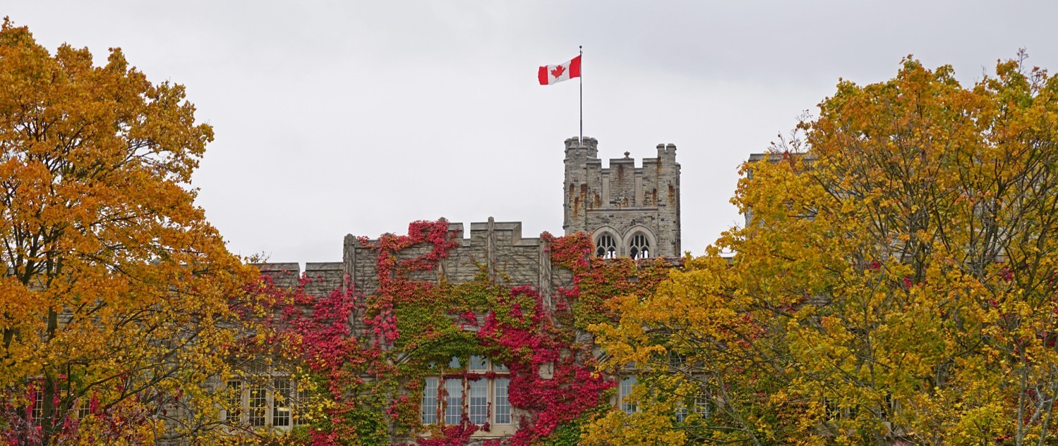
The Western Academy for Advanced Research
uwo.ca/academy | wafar@uwo.ca | @WesternUAcademy

Slide 2

Agenda
Introducing The Western Academy for Advanced Research
Personnel
Themes
Proposals
Applications
The Western Academy for Advanced Research

Slide 3
Aspiration
To elevate the global impact and international reputation of Western through a sustained contribution of new ideas that influence societal directions and contribute in substantial ways to the well-being of humanity.
The Western Academy for Advanced Research

Slide 4
Mission
To seek solutions to major issues facing humanity through focused enquiry that combines the spectrum of scholarship at Western with that from around the world.
Interdisciplinary
The Western Academy for Advanced Research

Slide 5
Mandate
Facilitate and adjudicate theme selection
Facilitate selection of major participants
Western Fellows, incl. Theme Leaders
Western Academy Postdoctoral Scholars
Annual Competition
Visiting Western Fellows
The Western Academy for Advanced Research

Slide 6
Mandate
Provide an organizational structure and place for delivery of themes, and financial support for:
Visiting Western Fellows
Western Academy Postdoctoral Scholars
Seconded Western Fellows’ Units
Theme Activities
Maximum $60K each, 12 months
Maximum $50K each, 12 months
Maximum $25K each, 12 months
Maximum $15K each, 12 months
The Western Academy for Advanced Research

Slide 7
Western Fellows
Seconded from units for duration of theme
Selected on basis of excellence and fit to theme
One Western Fellow designated as Theme Leader – normally the applicant
Western Fellows relieve of service and teaching duties, except graduate student supervision
Typically, three per theme
The Western Academy for Advanced Research

Slide 8
Visiting Western Fellows
Internationally established or emerging scholars, thinkers and/or leaders from university, government, private sector
Selected on basis of excellence and fit to theme
Stipend provided, but normally also requires salary support from home institution
Expected to reside at Western for duration of theme
Typically, two per theme
The Western Academy for Advanced Research

Slide 9
Western Academy Postdoctoral Scholars
Competitively selected to work with Western Fellows and Visiting Western Fellows for duration of theme
Typically, two per theme
The Western Academy for Advanced Research

Slide 10
Others
Graduate students working with Western Fellows and Visiting Western Fellows should be welcomed to participate in a theme
Participation of other faculty members, community members, members of government and private sectors, as deemed appropriate, is encouraged
The Western Academy for Advanced Research

Slide 11
Themes
Plan is to support two themes of normal duration (10-12 months) per year during initial years of operation
  Shorter terms may be considered on case-by-case basis
Hosting a larger number of themes annually may be considered in the future
The Western Academy for Advanced Research

Slide 12
Themes
Themes are to be of broad public significance and involve topics that can benefit from ideas drawn from across the spectrum of scholarship and sectors
Themes will be chosen for relevance to current major issues affecting Canada and the world, and for the prospects of making a significant advance in thinking that would influence directions of society, governments, and the broader public and private sectors
Strong emphasis on public dissemination of outcomes
The Western Academy for Advanced Research

Slide 13
Hypothetical Examples
Addressing Climate Change & Creating a Sustainable Earth
After the Pandemic: Shape, Role and Responsibility of the Research-Intensive University
Building Resilient Cities
Breaking the Addiction, Homelessness and Poverty Cycle
Curbing Violence in Modern Society
Embracing Sustainable Development in A Crowded World
Sustaining Literacy and Reason in a Changing World
Understanding Populism and the Future of Democracy
Seeking Proposals
The Western Academy for Advanced Research

Slide 14
Proposing a Theme
Significance of problem to Canadian and global contexts
  Topics to be addressed
How solutions will be sought from across the spectrum of scholarship
  How the wider community will be engaged in the work
Proposed mix and match of the team
  EDI considerations
How ideas and results will be disseminated
  How global impact will be achieved and assessed
Work plan and timetable
Two Themes Per Year
The Western Academy for Advanced Research

Slide 15
Adjudication
Proposals for themes and participants are adjudicated by the Academic Steering Committee, which makes recommendations to the Vice-President (Research) and Provost & Vice-President (Academic)
The Academic Steering Committee is not yet appointed, but is anticipated to include Members of the Royal Society of Canada’s (RSC) College of New Scholars, Artists, and Scientists, Distinguished University Professors, Hellmuth Prize winners, Canada Research Chairs, and Fellows of the RSC
Your Suggestions Welcome
The Western Academy for Advanced Research

Slide 16

The Final Frontier –
we’re working on it
Space
Not in a Galaxy Far Far Away (WAFAR)

Slide 17
Application Process
The Western Academy for Advanced Research

Slide 18
Application Process
Normally a two-step process
Will be folded into a one-step process for theme activity starting in September 2022
The Western Academy for Advanced Research

Slide 19
Inaugural Year Application Process
Themes, Theme Leaders, Western Fellows and Visiting Western Fellows selected from applications received
Two parts to application:
  Part 1: Principal applicant details how theme meets Academy criteria, proposed team and why Western is the right venue
  Part 2: Completed by proposed Fellows
The Western Academy for Advanced Research
Notes:
Part 1 – the principal applicant details how the theme meets Western Academy criteria and why Western is the right venue
Part 2 – the proposed team is described and justified. Part 2 includes sub-sections completed by proposed Western Fellows and Visiting Western Fellows. It is the principal applicant’s responsibility to coordinate, gather and submit these subsections with the Theme application

Slide 20
Timelines
Call for proposals for themes to begin September 2022 will be issued on or before June 4, 2021
Application deadline is September 30, 2021, with decisions to follow within six weeks
COVID uncertainty may affect delivery
Not all worthy proposals can be funded in any one year
Proposals submitted for September 2023 and later will follow a two-step process
The Western Academy for Advanced Research

Slide 21
The Western Academy for Advanced Research
Fred J Longstaffe, Director
wafar@uwo.ca
uwo.ca/academy
@WesternUAcademy
Thank you for your attention!
The Western Academy for Advanced Research

