Slide 1
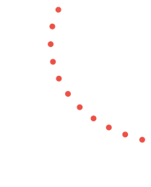
The Aesthetic Education in the Reggio Emilia Approach Presenter: Lorenzo Manera, University of Modena and Reggio Emilia, Reggio Children Foundation - Centro Loris Malaguzzi,
January 14th, 2022
www.frchildren.org

Slide 2
The key features of the
Reggio Emilia Approach
Notes:
use: image of the child, 100 languages, role of adult, documentation, partecipazione, environment

Slide 3
The key features of the
Reggio Emilia Approach
Publications
Fernández-Santín, M., Feliu-Torruella, M. (2020).
Rinaldi (2021)
Vecchi (2010)
Notes:
foto LF giusto?

Slide 4
The key features of the
Reggio Emilia Approach
Long-term projects
Teachers and educators are also researchers
The image of the “competent” child
Children with special rights
Negotiated learning
Pedagogical documentation
The extension of the term "language"
Fernández-Santín, M., Feliu-Torruella, M. (2020).
Notes:
foto LF giusto?

Slide 5
The key features of the
Reggio Emilia Approach
Publications
(1) the value attributed to creativity as a quality of human thinking, manifested in the atelier and the figure of the atelierista;
(2) the value of the theory-practice relationship symbolized by working teams of teachers, pedagogistas and others.
(3) the value of reflection as a formative element represented by pedagogical documentation.
Rinaldi (2021)
Notes:
foto LF giusto?

Slide 6
The key features of the
Reggio Emilia Approach
Publications
P. 71:
It was innovative to persevere in declaring aesthetics as an element of rights, part of children’s rights,
together with participation of families (among others) which was also defined as a right of the family but especially of the child and the teacher.
Rinaldi (2021)
Notes:
foto LF giusto?

Slide 7
The key features of the
Reggio Emilia Approach
Publications
The concept of aesthetic vibration:
first proposed by Malaguzzi, who described it as “a sensory perception that pushes to improve the constructs of our interpretive and creative sensibilities” (Malaguzzi, 1993, p. 81)
the aesthetic dimension is meant to be an activator of learning processes:
“If aesthetics fosters sensibility and the ability for connecting things far removed from each other, and if learning takes place through new connections between disparate elements, then aesthetics can be considered an important activator for learning”
Vecchi (2010)
Notes:
foto LF giusto?

Slide 8
Expressive languages: drawings as visual theories
Pictures from the project 𝗚𝗿𝗲𝗲𝘁𝗶𝗻𝗴𝘀 𝘁𝗼 𝘁𝗵𝗲 𝗰𝗶𝘁𝘆 (2021)
Notes:
Play and learning, divided and forced into a duality as strong as the ancient one of mind and body, are re-united in the metaphor of the butterfly; its wings, moving with fractions of a second of difference, independent but dependent, create that balance and dynamism that allow it to fly. Like play and learning, butterfly wings are parts of a single body, of a single organism in motion.

Slide 9
Expressive languages: drawings as visual theories
Pictures from the project 𝗚𝗿𝗲𝗲𝘁𝗶𝗻𝗴𝘀 𝘁𝗼 𝘁𝗵𝗲 𝗰𝗶𝘁𝘆 (2021)
Notes:
Play and learning, divided and forced into a duality as strong as the ancient one of mind and body, are re-united in the metaphor of the butterfly; its wings, moving with fractions of a second of difference, independent but dependent, create that balance and dynamism that allow it to fly. Like play and learning, butterfly wings are parts of a single body, of a single organism in motion.

Slide 10
Expressive languages: drawings as visual theories
Pictures from the project 𝗚𝗿𝗲𝗲𝘁𝗶𝗻𝗴𝘀 𝘁𝗼 𝘁𝗵𝗲 𝗰𝗶𝘁𝘆 (2021)
Notes:
Play and learning, divided and forced into a duality as strong as the ancient one of mind and body, are re-united in the metaphor of the butterfly; its wings, moving with fractions of a second of difference, independent but dependent, create that balance and dynamism that allow it to fly. Like play and learning, butterfly wings are parts of a single body, of a single organism in motion.

Slide 11
Expressive languages: drawings as visual theories
Pictures from the project 𝗚𝗿𝗲𝗲𝘁𝗶𝗻𝗴𝘀 𝘁𝗼 𝘁𝗵𝗲 𝗰𝗶𝘁𝘆 (2021)
Notes:
Play and learning, divided and forced into a duality as strong as the ancient one of mind and body, are re-united in the metaphor of the butterfly; its wings, moving with fractions of a second of difference, independent but dependent, create that balance and dynamism that allow it to fly. Like play and learning, butterfly wings are parts of a single body, of a single organism in motion.

Slide 12
The metaphor of the hundred languages and aesthetic education
Publications
The hundred languages: the graphic, pictorial, sculptural, plastic, mathematical, poetic languages”
The aesthetic experience is understood as a process of interrogation, an occasion to develop new forms of perception, to challenge and revise normative standards and inherited conventions
Aimed to value the legitimacy of various forms of expression
Malaguzzi and Goodman aesthetic perspective.
Notes:
foto LF giusto?

Slide 13
The metaphor of the hundred languages and aesthetic education
Publications
The relationship between aesthetic experiences and the creation of new meanings is “more familiar to children than we normally think. This hypothesis is supported by the testimony of Howard Gardner and from the inexhaustible research of Nelson Goodman on the genius of symbolic languages” (Malaguzzi, 2002, p. 37).
Reggio Emilia Approach and Goodman’s project zero:
Both aim at overcoming the dichotomies between
emotional and cognitive,
artistic and scientific fields,
sharing the idea that artistic understanding requires a complex, constructive and active process, rather than being the result of passive contemplation.
Picture from “Quaderni” Supplemento de “il Tratto” (13), 2019.
Notes:
foto LF giusto?

Slide 14
The metaphor of the hundred languages and aesthetic education
Publications
Contini (2019)
Art education appears as a requisite and integrated component of the entire educational process” (Contini, 2019, p. 160).
Picture from “Quaderni” Supplemento de “il Tratto” (13), 2019.
Notes:
foto LF giusto?

Slide 15
Ecological- relational perspectives and the extension of the term "language"
Reinterpretation of the Image of the child:
human being within a systemic paradigm, part of an ecological and relational system and the protagonist of a complex system of learning strategies.
Picture from “Quaderni” Supplemento de “il Tratto” (13), 2019.
Notes:
foto LF giusto?

Slide 16
Ecological- relational perspectives and the extension of the term "language"
Reinterpretation of Edgar Morin’s theory of complexity:
Ecological perspective as an epistemology that requires us to re-establish connections between what is (or seems) disjointed.
Picture from “Quaderni” Supplemento de “il Tratto” (13), 2019.
Notes:
foto LF giusto?

Slide 17
Learning environments and the concept of “shared aesthetics” in the Reggio Emilia Approach
This concept refers to the idea that the aesthetic dimension is a relevant aspect of the pedagogical quality of the scholastic and educational space.
An attractive and welcoming ecosystem, a relational space where the interactions implemented and created emerge as the predominant elements.
Picture from “Quaderni” Supplemento de “il Tratto” (13), 2019.
Notes:
foto LF giusto?

Slide 18
Learning environments and the concept of “shared aesthetics” in the Reggio Emilia Approach
The educational space is not defined according to a rigid functional order, but rather it is a metaphor of knowledge, to challenge many false dichotomies: art versus science, individual versus community, enjoyment versus study.
Picture from “Quaderni” Supplemento de “il Tratto” (13), 2019.
Notes:
foto LF giusto?

Slide 19
Learning environments and the concept of “shared aesthetics” in the Reggio Emilia Approach
Caring for the furniture and objects generates a sense of familiarity and belonging, an appreciation for beauty and aesthetics.
Relationship-sensitive environments, capable of acknowledging and valuing the traces left by children
© Progetto FARE SCUOLA, Reggio Children Foundation
Notes:
foto LF giusto?

Slide 20
Affordances
The Reggio Emilia Approach provides the possibility to explore the physical properties of different materials and media
allowing children to become more familiar with the affordances of objects and media, increasing their sense of agency.
Picture from “Quaderni” Supplemento de “il Tratto” (13), 2019.
Notes:
foto LF giusto?

Slide 21
Metaphors
The “metaphor corresponds to an investigative attitude towards reality, participation that allows our thoughts to broaden and break down the rigid boundaries that are usually constructed. I see metaphor as a genuine system for organizing intellectual development” (Vecchi, 2010, p. 34).
Picture from “Quaderni” Supplemento de “il Tratto” (13), 2019.
Notes:
foto LF giusto?

Slide 22
Metaphors
Its use and understanding first of all require the creation of original categories;
It concerns the reconfiguration of cognitive meanings and the development of complex inferential and conceptual processes
Picture from
https://www.reggiochildren.it/assets/Uploads/Rechild-Dicembre-2018.pdf.
Notes:
foto LF giusto?

Slide 23
Visual metaphors
Visual metaphors are images that stimulate the observer to project one or more traits that belong to the source domain onto the target domain, allowing “interpreters to see one thing as another with which the first is not ordinarily associated”.
Picture from
https://www.reggiochildren.it/assets/Uploads/Rechild-Dicembre-2018.pdf.
Notes:
foto LF giusto?

Slide 24
Visual metaphors
The act of comparing and connecting objects and images that belong to different conceptual domains is reinforced by the exploration of the similarities that children can identify in the visual characteristics of different objects.
Picture from
https://www.reggiochildren.it/assets/Uploads/Rechild-Dicembre-2018.pdf.
Notes:
foto LF giusto?

Slide 25
The atelier and the exploration of artistic techniques
The concept of the Atelier is a place closely connected with the other spaces of the school, entrusted to a person with artistic training (the so-called atelierista), aimed to enhance the “hundred languages” of children.
Picture from “Quaderni” Supplemento de “il Tratto” (13), 2019.
Notes:
foto LF giusto?

Slide 26
The atelier and the exploration of artistic techniques
The introduction of the Atelier in each Municipal Preschool was an intuition and a choice that contributed to the construction of an original educational philosophy where “the aesthetic dimension and the research of beauty have been adopted as important dimensions in the life of our species and thus also in the school and in learning” (Giudici & Cagliari, 2018 p. 1467).
Picture from
https://startupitalia.eu/39935-20160111-reggio-emilia-approach.
Notes:
foto LF giusto?

Slide 27
The atelier and the exploration of artistic techniques
“We wanted to create possibilities to refine taste and aesthetic sensibility, to observe and find theories about children starting from scribbles and going forward. We also wanted to try out tools, materials, and techniques” (Malaguzzi, 1988, p. 28).
Picture from
https://startupitalia.eu/39935-20160111-reggio-emilia-approach.
Notes:
foto LF giusto?

Slide 28
The atelier and the exploration of artistic techniques
Estrangement: a concept that refers to a device able to interrupt routinized forms of perception, provoking a shifting from how a certain element normally appears to us
Children’s aesthetic education should be a form of escape from rhetoric and stereotypes through encountering the possibilities offered by different artistic techniques.
Picture from “Quaderni” Supplemento de “il Tratto” (13), 2019.
Notes:
foto LF giusto?

Slide 29
The atelier and the exploration of artistic techniques
Working alone and in groups, these processes sustain children in becoming more knowledgeable about the different affordances that materials and media can express, the immediate (salient) and hidden (supervenient) emergences that different objects evoke, confronting their views with their peers and the adults coordinating the experiences.
Picture from “Quaderni” Supplemento de “il Tratto” (13), 2019.
Notes:
foto LF giusto?

Slide 30
The affordances of materials and the role of documentation
Children can explore the affordances of materials and objects discarded from end-product manufacturing which are carefully selected by the adults and offered to small groups of children in order to find new possible meanings, new expressive purposes.
Picture from “Quaderni” Supplemento de “il Tratto” (13), 2019.
Notes:
foto LF giusto?

Slide 31
The affordances of materials and the role of documentation
The exploration of artistic techniques leads to considering the objects with a different view, exploiting connections and relationships not previously explored.
Picture from “Quaderni” Supplemento de “il Tratto” (13), 2019.
Notes:
foto LF giusto?

Slide 32
The atelier and the exploration of artistic techniques
Digital technologies foster the exploration of unusual perspectives, destructuring perception and eliciting the emergence of new affordances by acting on different representational and symbolic levels.
Notes:
foto LF giusto?

Slide 33
The atelier and the exploration of artistic techniques
In order to make visible both the process of exploring the affordances and meaning-making, documentation plays a pivotal role. It refers which refers to both visual and written documents able to record an experience in sufficient detail to help others understand the processes observed.
Notes:
foto LF giusto?

Slide 34
Material engagement theory, agency and interactive imagination
In the aesthetic perspective that defines the Reggio Emilia Approach, developing children’s sense of agency does not mean deliberately imposing or externalizing pre-formed ideas on matter. On the contrary, it signifies developing a hybrid coalition, an evolving tension with the materials and technologies available, explored through different artistic techniques.
Notes:
foto LF giusto?

Slide 35
Material engagement theory, agency and interactive imagination
In the MET (Malafouris, 2013), the design intent is considered an aspect that emerges within a material engagement process, implying a cognitive dimension as well as perceptual aspects.
Notes:
foto LF giusto?

Slide 36
Material engagement theory, agency and interactive imagination
Within this perspective, the interactive quality of imagination emerges in its constant relationship with the “things” of the world-environment and the sphere of their affordances.
Picture from “Quaderni” Supplemento de “il Tratto” (13), 2019.
Notes:
foto LF giusto?

Slide 37
Conclusion
The Reggio Emilia Approach, by focusing on visual and expressive languages as a means of inquiry regarding the affordances that various materials and technologies express on different representational and symbolic levels, fosters the development of aesthetic education models which promote children’s interactive agency and imagination.
Notes:
foto LF giusto?

Slide 38
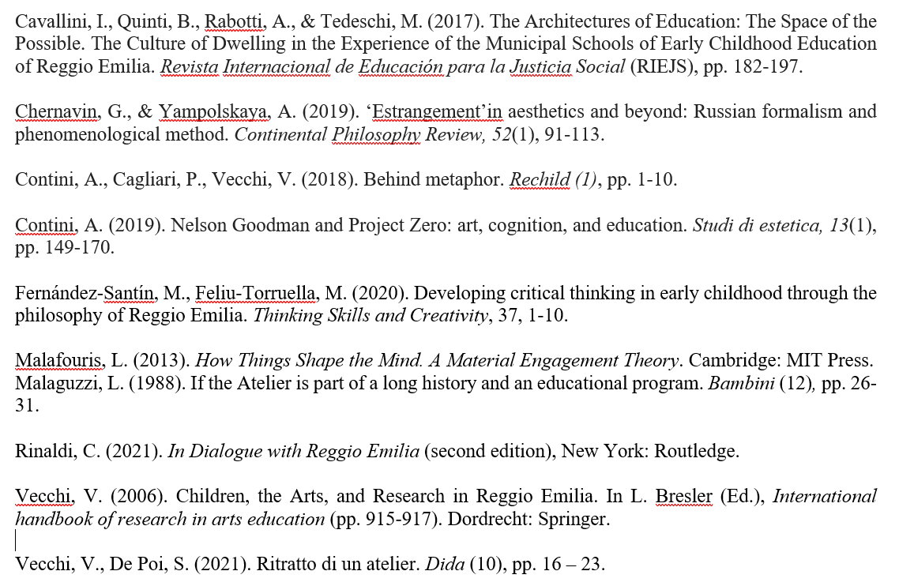
References
Notes:
foto LF giusto?

Slide 39
scintillae - play and learning in the digital age
The LEGO Foundation
holistic skills
www.scintillae.org
Notes:
didascalia
scintillae has brought the most innovative aspects and practices of the Reggio Emilia Approach® and Learning through Play together in promoting the value and potency of play as a pathway, context and vehicle for learning, both in informal and formal settings.
The values and philosophy of the Reggio Emilia Approach, together with the 5 characteristics of playful learning experiences, broaden and deepen the work being done by the two partners regarding research and experiences on the themes of play and learning, overlapping in some areas and adding new dimensions to one another.
What is currently being created- a hybrid between the two realities- is still at an early stage of development, but there are some significant experiences and ideas which illustrate this new scenario.

Slide 40
A shared definition of the relationship between play and learning
Play and learning, divided and forced into a duality as strong as the ancient one of mind and body, are
re-united in the metaphor of the butterfly;
its wings, moving with fractions of a second of difference, independent but dependent, create a balance and dynamism that allow it to fly.
Like play and learning, butterfly wings are parts of a single body, of a single organism in motion...
Notes:
Play and learning, divided and forced into a duality as strong as the ancient one of mind and body, are re-united in the metaphor of the butterfly; its wings, moving with fractions of a second of difference, independent but dependent, create that balance and dynamism that allow it to fly. Like play and learning, butterfly wings are parts of a single body, of a single organism in motion.

Slide 41
Technology in playful learning contexts
Some documentation from TIDA:
Project for a space aiming to create connections, different points of view, dialogues among natural and artificial lights and tools.
An artistic setting that could be designed through coding.
Materials chosen for their different features which raised questions and promoted exploration of possibilities in relation to light.
“Intelligent” materials in dialogue with the “tool” selected by children and adults during the experiences.
Project to make the space more immersive and circular by introducing mobile torch lamps and the possibility of several surfaces on which to project images.

Slide 42
from our initial research questions
4 fields of research:
creativity & digital environments
04
playful parenting
03
playful learning at schools
playful learning in non-formal contexts
02
01
to new research directions

Slide 43
Seeds for the future:
natural digital
research approach
environment / context
playful attitude / atmosphere
learning
as individuals
and as a group

